Slide 1
| LABORATORY OF INSTRUMENTAL METHODS IN FOOD ANALYSIS|
| Winter semester 2020/2021|
Lab exercise
Coupling bioanalytical assays to smartphone-based devices in food analysis
Part C. CAD design and 3D-printing
Aris Tsagkaris M.Sc., Ph.D.

Slide 2
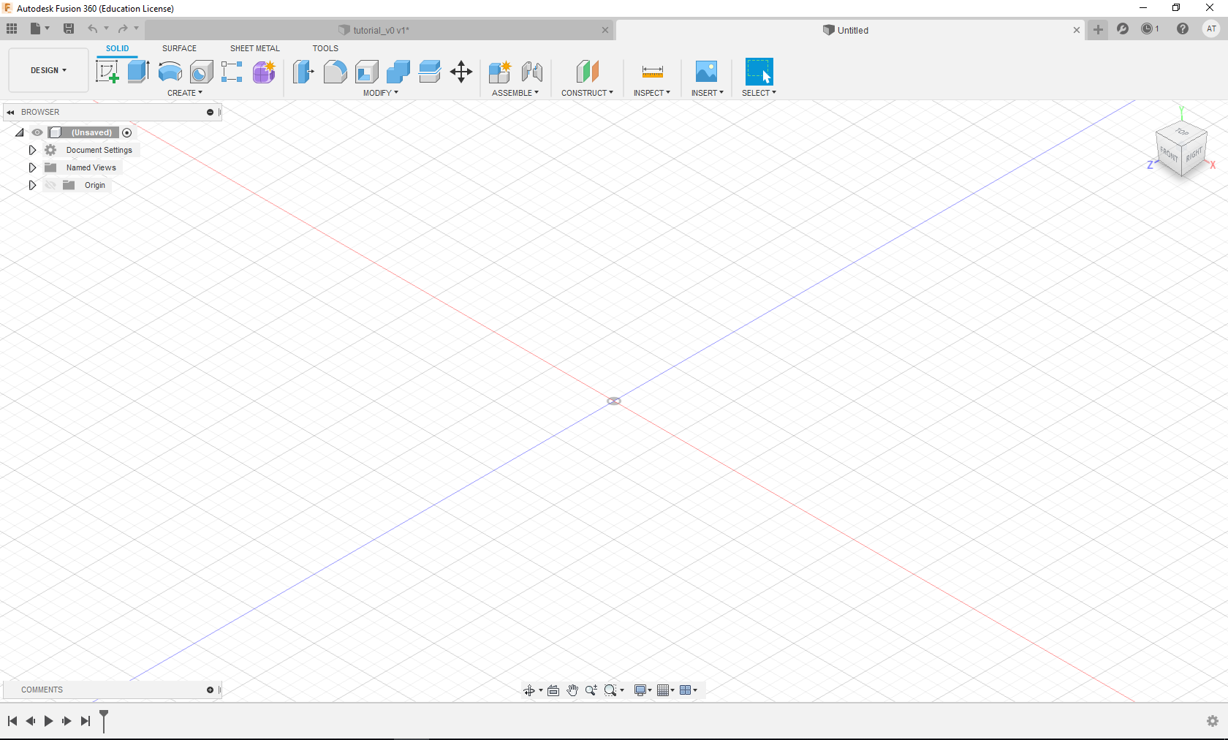
FIRST SCREEN
0) Download fusion360 software and register using your university accoumt

Slide 3
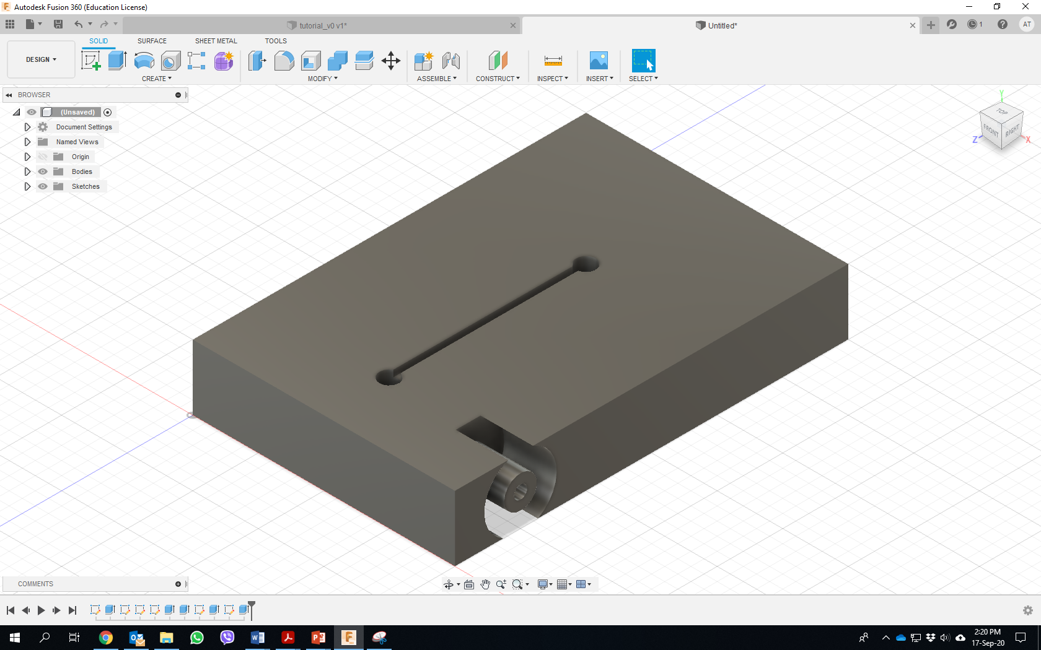
DESIGNED DEVICE

Slide 4
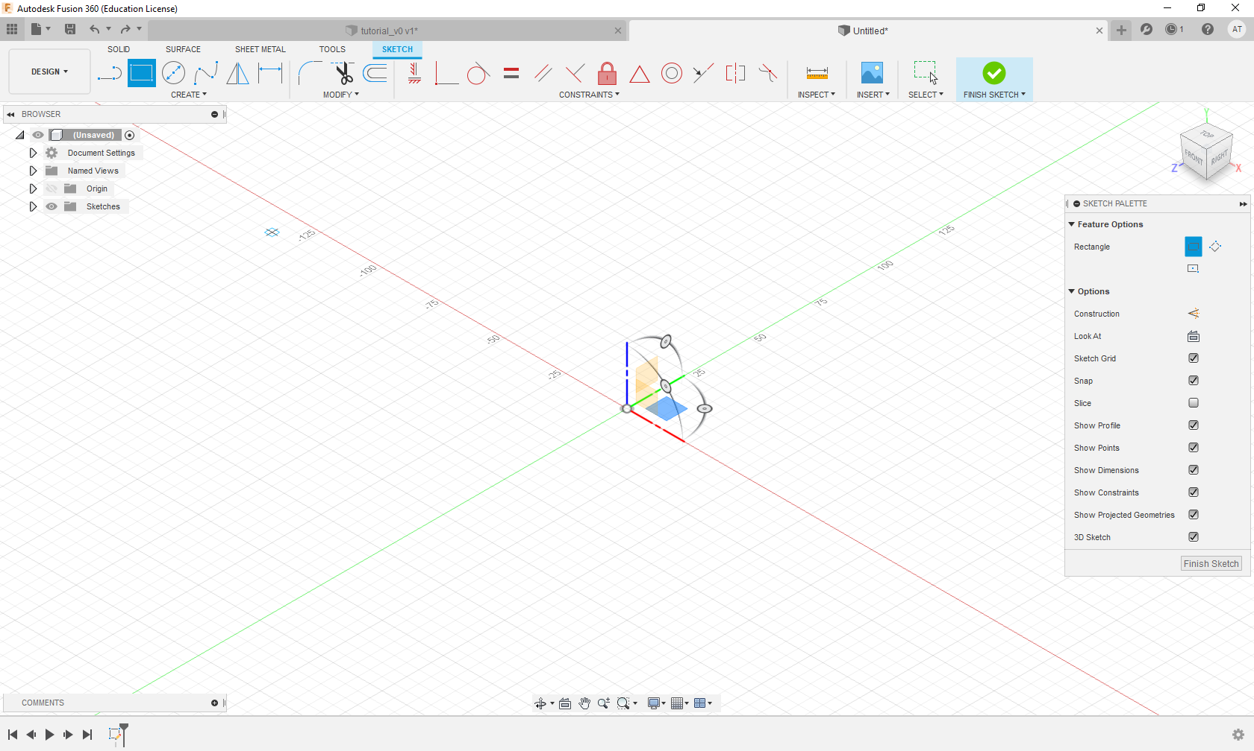
1) Select rectangle tool
The orthogonal axes will appear

Slide 5
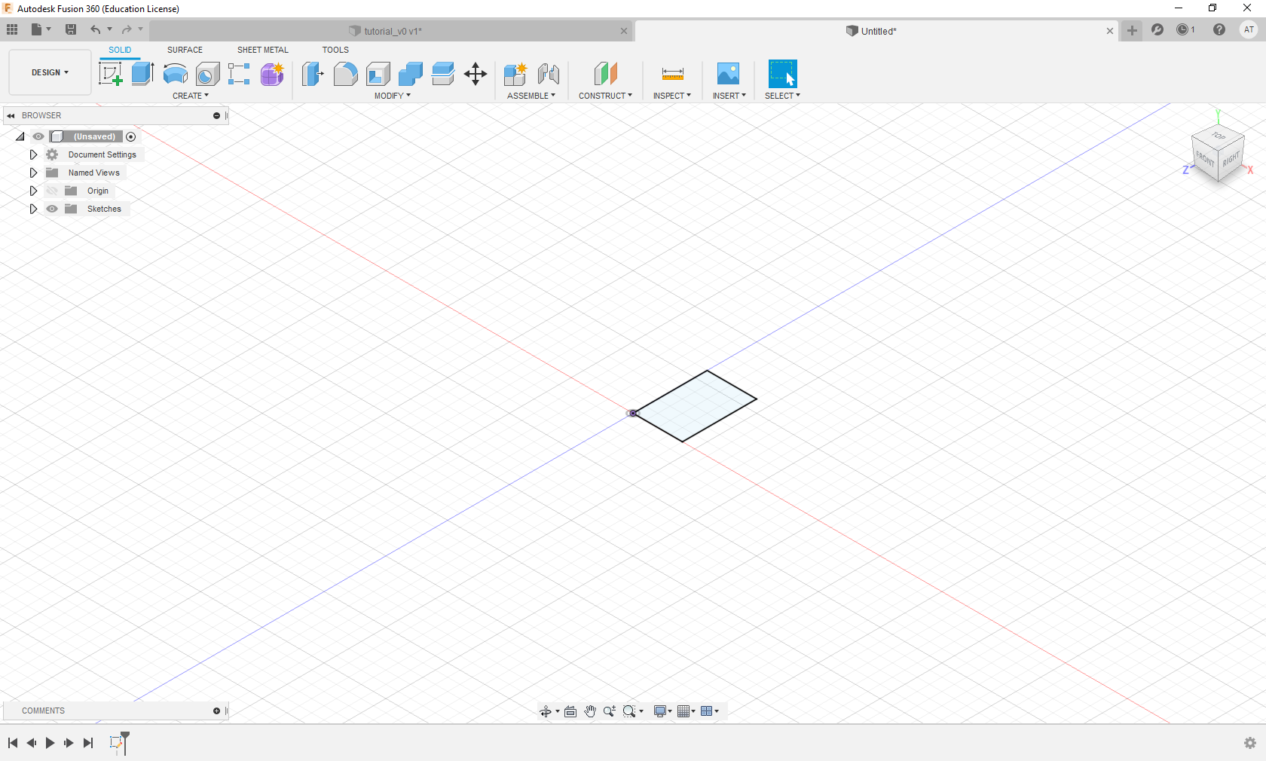
2) Set rectangle dimensions

Slide 6
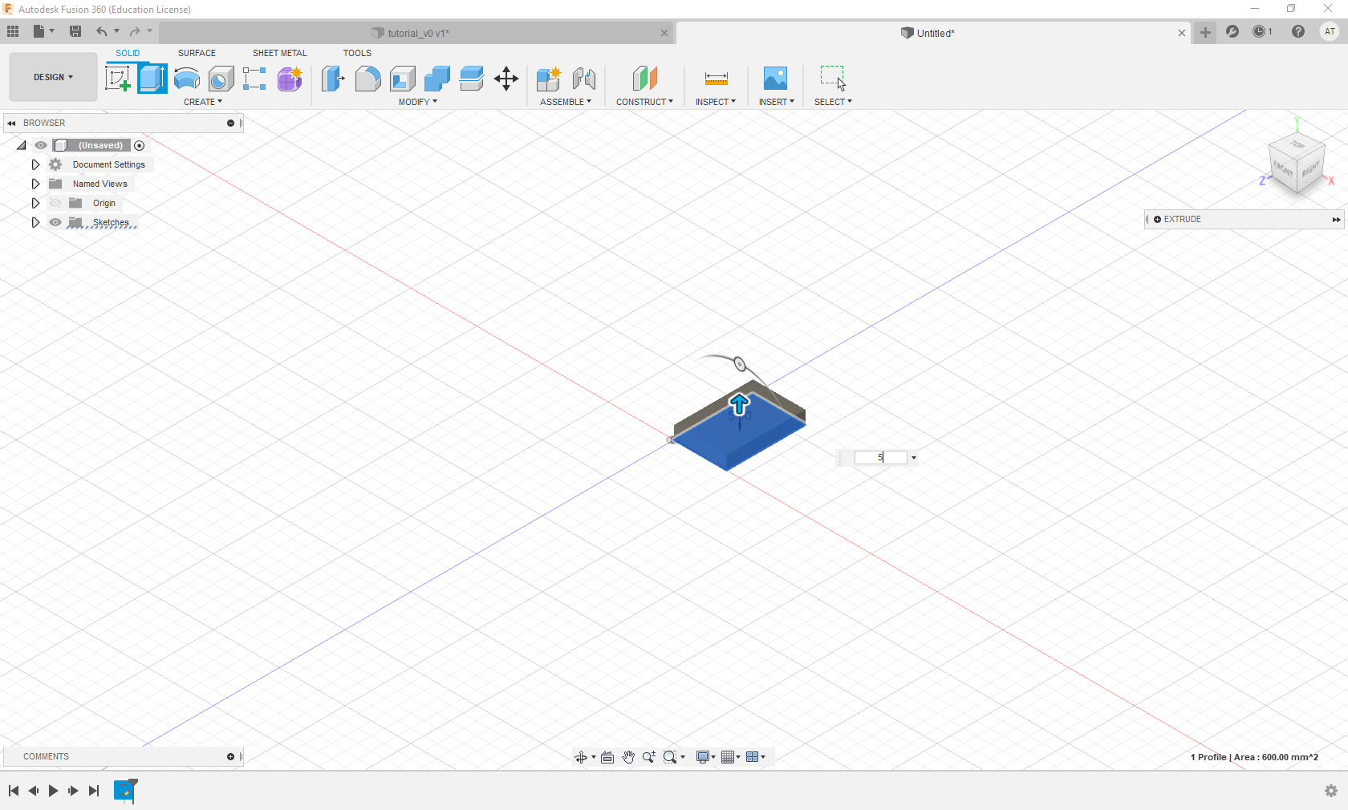
3) Select Extrusion tool
4) Set the thickness (in mm)

Slide 7
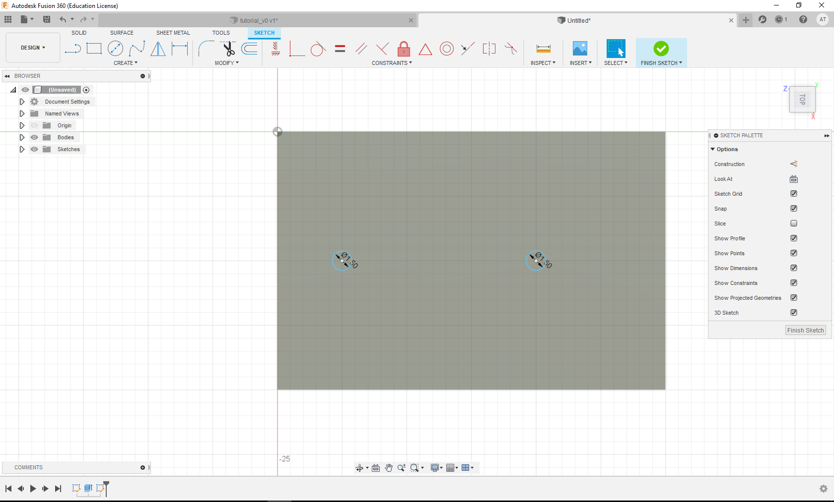
5) Select Working view (Click on TOP to in this case)
7) Select the circular tool and sketch two circles with same diameter
6) Select a Sketch tool and select the working plane

Slide 8
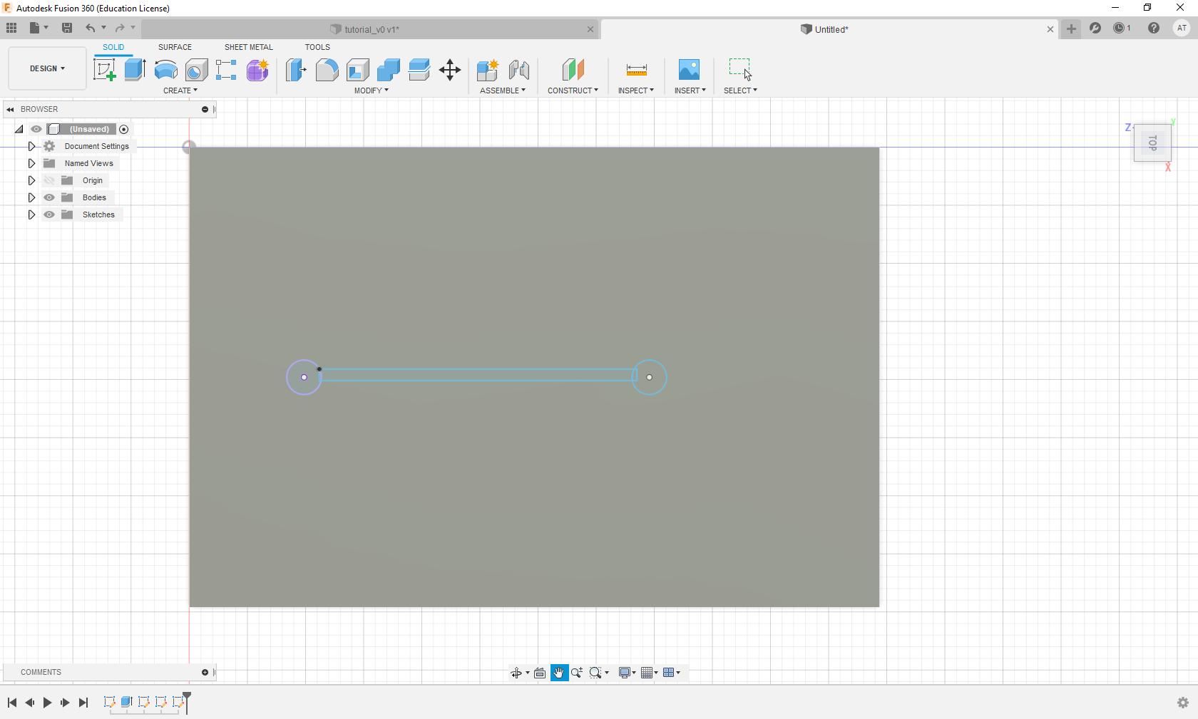
8) Create a channel using the rectangle tool (see step 1)

Slide 9
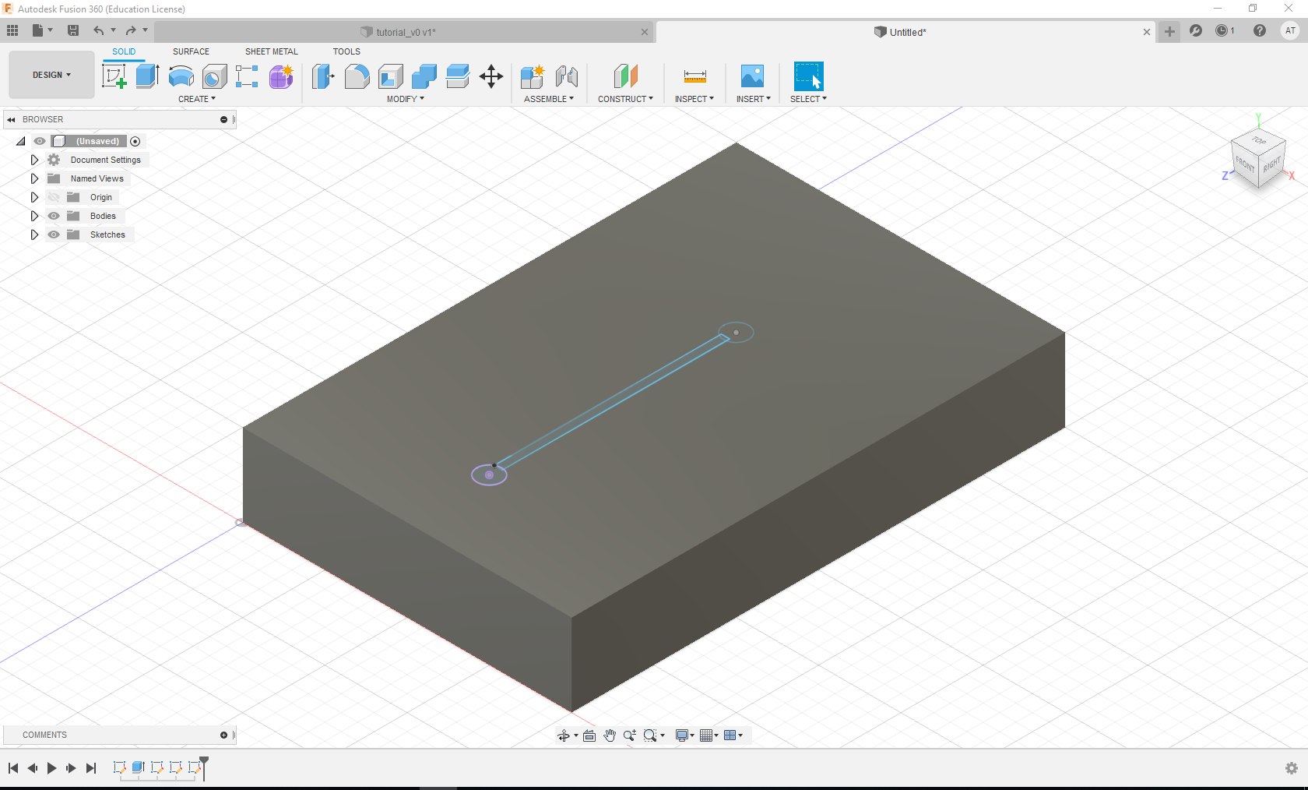
9) Choose “home”

Slide 10
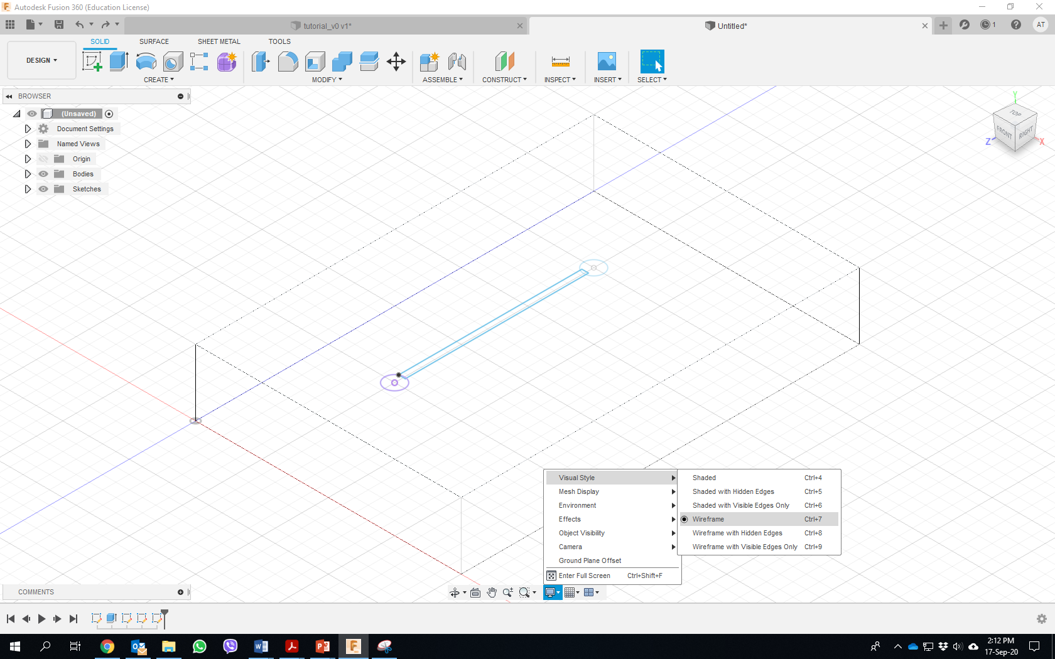
10) Choose “wireframe” view

Slide 11
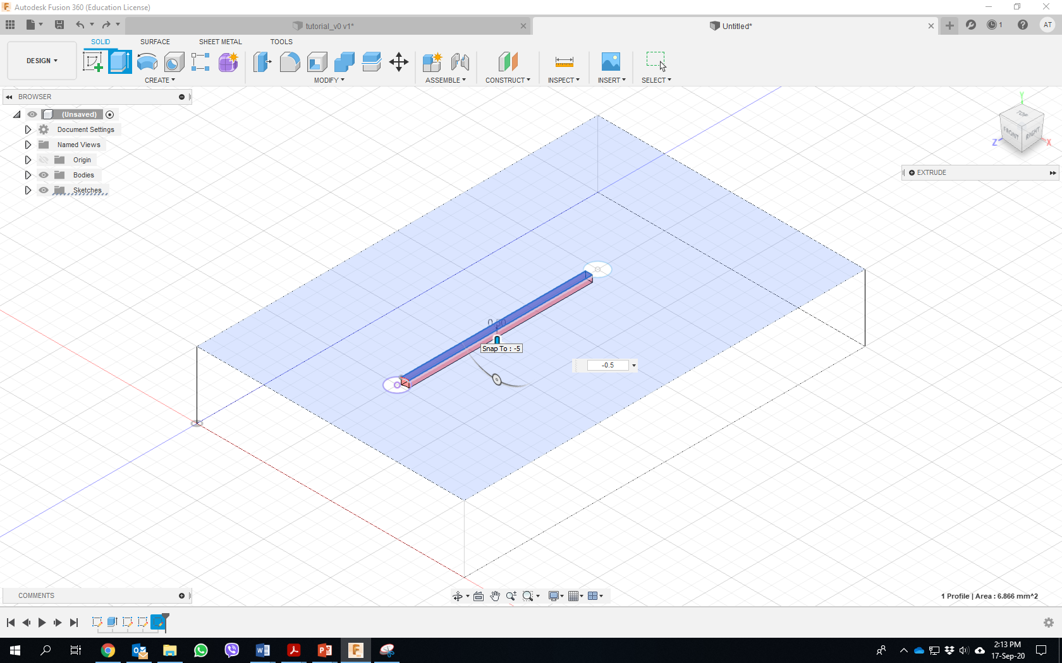
11) Extrude the channel

Slide 12
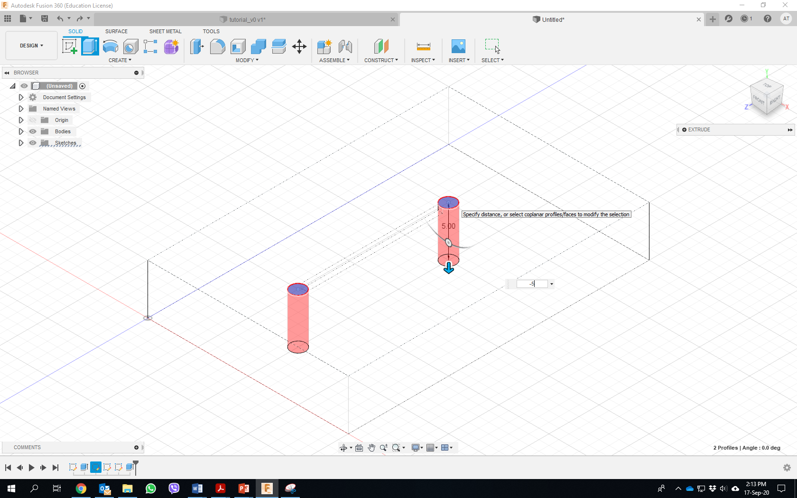
12) Open “holes” using the extruding tool

Slide 13
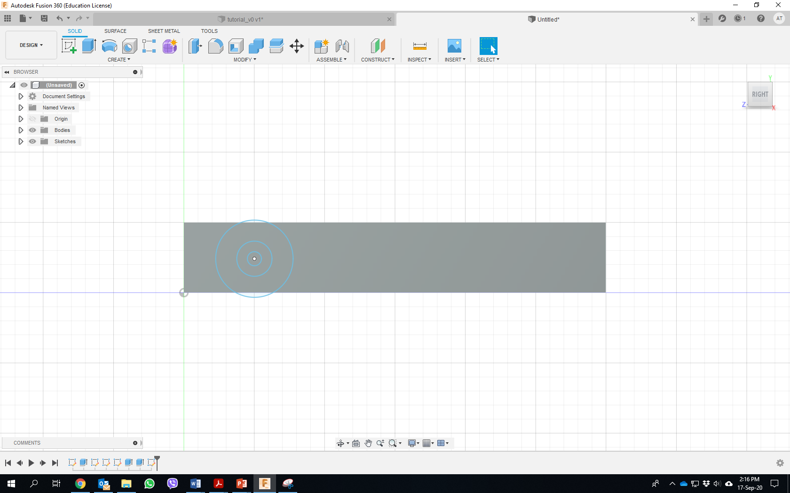
13) Design three circles with the same circle center – 5 mm, 2.5 mm & 1 mm

Slide 14
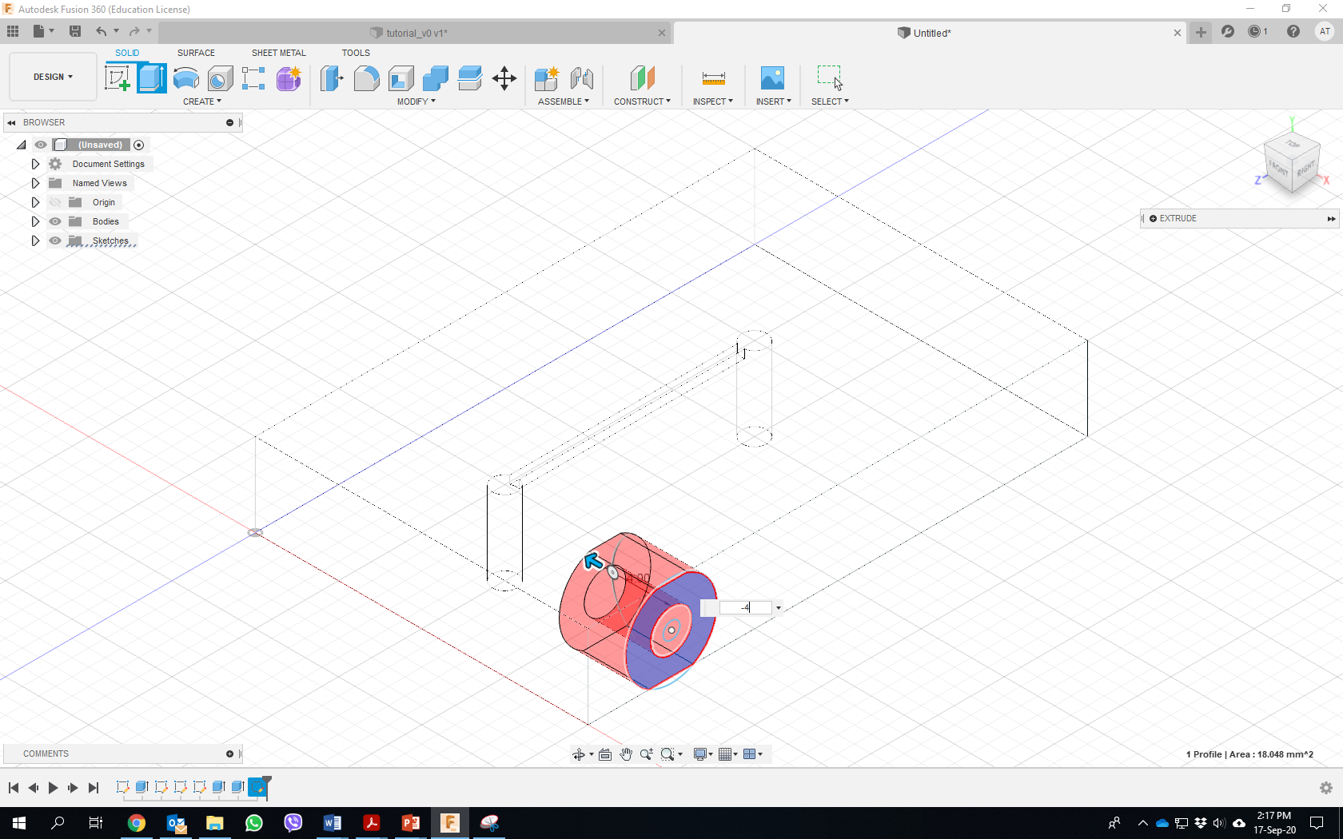
14) Extrude the “big circle” (- 4 mm)

Slide 15
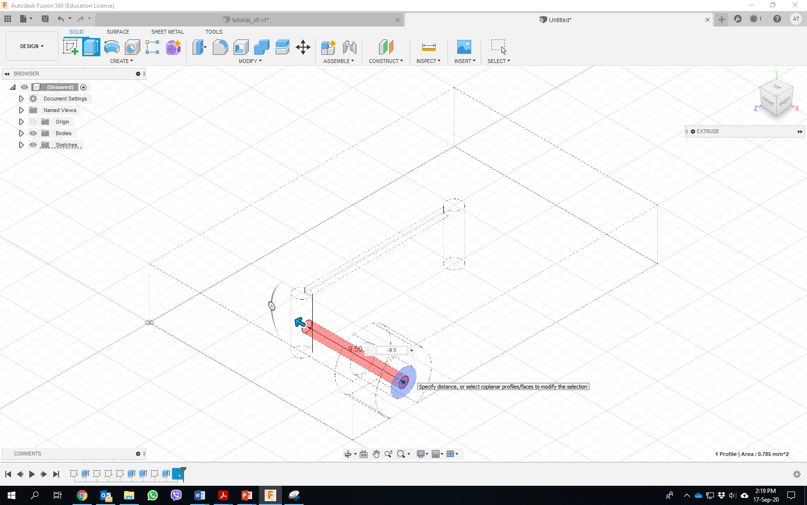
15) Extrude the “small circle” (- 9.5 mm)

Slide 16
16) Transform to .stl and load to printer

