Slide 1
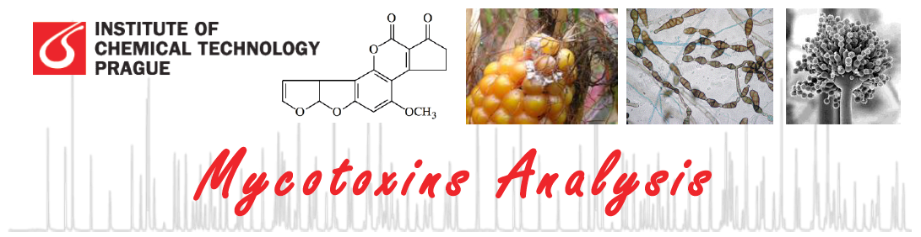
Liquid chromatography
Ondřej Lacina
Department of Food Chemistry and Analysis, ICT Prague
Thursday, April 7, 2011

Slide 2
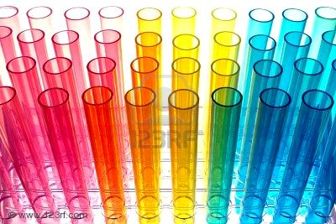
What is chromatography?
Derived from the Greek word Chroma meaning colour, chromatography provides a way to identify unknown compounds and separate mixtures.

Slide 3
Introduction to Chromatography
Definition:
Chromatography is a separation technique based on the different interactions of compounds with two phases, a mobile phase and a stationary phase, as the compounds travel through a supporting medium.
Components:
  Mobile phase: a solvent that flows through the supporting medium.
  Stationary phase: a layer or coating on the supporting medium that interacts with the analytes.
  Supporting medium: a solid surface on which the stationary phase is bound or coated.

Slide 4
Milestones in Chromatography
1903 Tswett - plant pigments separated on chalk columns
1931 Lederer & Kuhn - LC of carotenoids
1938 TLC and ion exchange
1950 reverse phase LC
1954 Martin & Synge (Nobel Prize)
1959 Gel permeation
1965 instrumental LC (Waters) Milestones in Chromatography

Slide 5
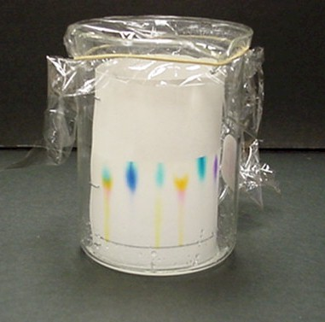
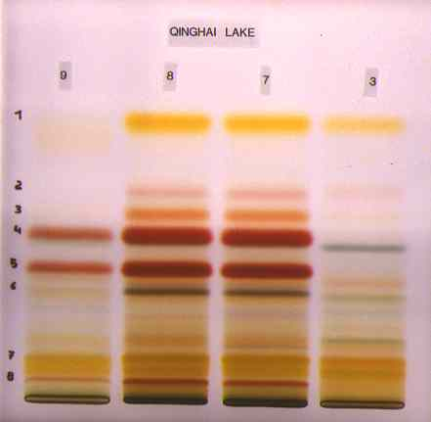
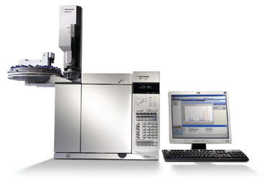
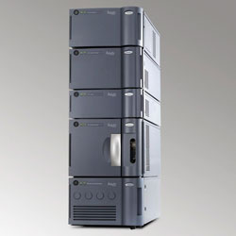
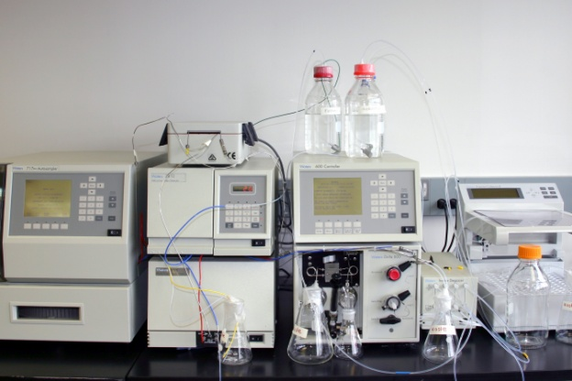
Types of Chromatography
Paper (PC)
Thin Layer (TLC)
Gas (GC)
Chromatography
Liquid (LC)
Supercritical Fluid (SFC)

Slide 6
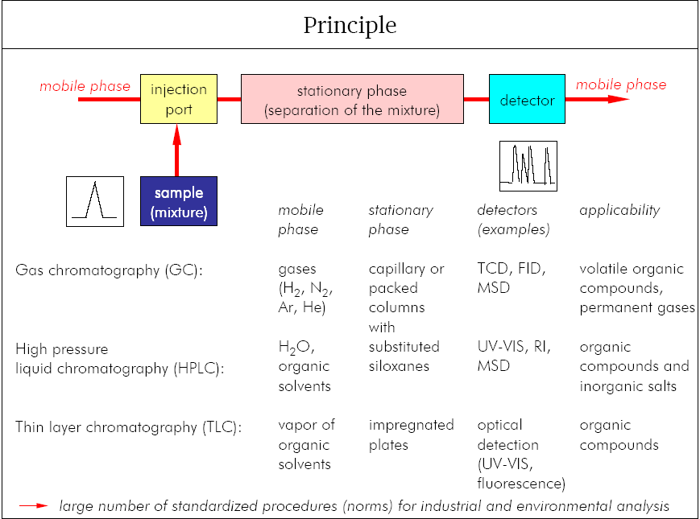
Types of Chromatography

Slide 7
Chromatographic methods classification
Geometry of the system:
Column chromatography: the stationary phase (solid particles) is in a tube called the column.
Planar chromatography: In this geometry the stationary phase is configured as a thin two-dimensional sheet.
  In paper chromatography a sheet or a narrow strip of paper serves as the stationary phase.
  In thin-layer chromatography a thin film of a stationary phase of solid particles bound together for mechanical strength with a binder, such as calcium sulfate, is coated on a glass plate or plastic or metal sheet.

Slide 8
Chromatographic methods classification
Mode of operation
Development chromatography
In terms of operation, in development chromatography the mobile phase flow is stopped before solutes reach the end of the bed of stationary phase. The mobile phase is called the developer, and the movement of the liquid along the bed is referred to as development.
  Example of planar development chromatography – TLC or PC
Elution chromatography.
This method, employed with columns, involves solute migration through the entire system and solute detection as it emerges from the column. The detector continuously monitors the amount of solute in the emerging mobile-phase stream—the eluate—and transduces the signal, most often to a voltage, which is registered as a peak on a strip-chart recorder.

Slide 9
Chromatographic methods classification
Phases involved (mobile phase)
The primary division of chromatographic techniques is based on the type of mobile phase used in the system:
Type of Chromatography Type of Mobile Phase
  Gas chromatography (GC) gas
  Liquid chromatography (LC) liquid

Slide 10
Chromatographic methods classification
Phases involved (stationary phase)
Further divisions can be made based on the type of stationary phase used in the system:
Gas Chromatography:
Name of GC Method:
Type of Stationary Phase
Gas-solid chromatography
Gas-liquid chromatography
Bonded-phase gas chromatography
Solid, underivatized support
Liquid-coated support
Chemically-derivatized support

Slide 11
Chromatographic methods classification
Phases involved (stationary phase)
Further divisions can be made based on the type of stationary phase used in the system:
Liquid Chromatography:
Name of LC Method:
Type of Stationary Phase
Adsorption chromatography
Partition chromatography
Ion-exchange chromatography
Size exclusion chromatography
Affinity chromatography
Solid, underivatized support
Liquid-coated or derivatized support
Support containing fixed charges
Porous support
Support with immobilized ligand

Slide 12
Chromatographic methods classification
Retention mechanism
Classification in terms of the retention mechanism is approximate, because the retention actually is a mixture of mechanisms. The main types of molecular interactive force are:
  Van der Wall interactions (hydrophobic)
  Polar (dipole-dipole: hydrogen bonding, π-π interactions)
  Ionic
  Special (affinity, chiral)

Slide 13
LC Separation
Main type of interactions in liquid chromatography
Van der Wall interaction (hydrophobic)
Dipole interaction
Hydrogen bond
π-π interactions
Electrostatic interaction
(ionic)

Slide 14
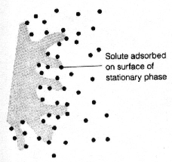
Principle of separation
Adsorption chromatography
Chromatography in which separation is based mainly on differences between the adsorption affinities of the sample components for the surface of an active solid.
Usually used anorganic sorbents Al₂O₃, SiO₂ etc.
Traditional adsorption chromatography is a „normal phase“ chromatography.

Slide 15
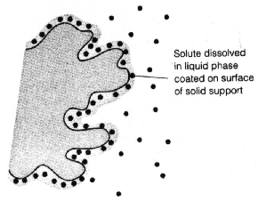
Principle of separation
Partition chromatography
Chromatography in which separation is based mainly on differences between the solubility of the sample components in the stationary phase (gas chromatography), or on different solubilities of the component between mobile and stationary phases (liquid chromatography).
Modified anorganic support
In LC could be both normal (polar stationary phase) and reversed (non-polar stationary phase).

Slide 16
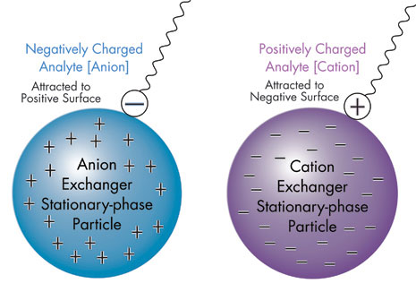
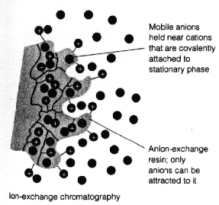
Principle of separation
Ion-exchange chromatography
Chromatography in which separation is based mainly on differences in the ion-exchange affinities of the sample components. Anions like SO₃⁻ or cations like N(CH₃)₃⁺ are covalently attached to stationary phase, usually a resin,

Slide 17
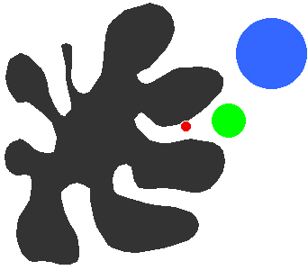
Principle of separation
Molecular exclusion chromatography
A separation technique in which separation mainly according to the hydrodynamic volume of the molecules or particles takes place in a porous non-adsorbing material with pores of approximately the same size as the effective dimensions in solution of the molecules to be separated.

Slide 18
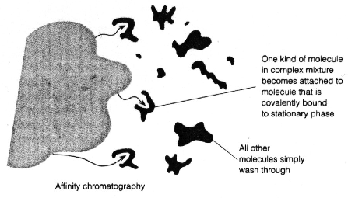
Principle of separation
Affinity chromatography
The particular variant of chromatography in which the unique biological specificity of the analyte and ligand interaction is utilized for the separation.

Slide 19
Theory of Chromatography
Typical response obtained by chromatography (i.e., a chromatogram): chromatogram - concentration versus elution time.
signal
t_{R(2)}
Component 2
t_{R(1)}
Component 1
W_{(h)}
t₀
W_{(b)}
t‘_{R(1)}
time (t)
t‘_{R(2)}
Sample injection (t = 0)
t₀ Void time = retention time of compound without retention
t_{R} Retention time
t‘_{R} Net retention time(t‘_{R} - t₀)
W_{(b)} Base peak width
W_{(h)} Half-of-height peak width

Slide 20
Theory of Chromatography
A similar plot can be made in terms of elution volume instead of elution time.
signal
Elution volume
(ml)
V_{R(2)}
Component 2
V_{R(1)}
Component 1
Elution time (min)
W_{(h)}
V₀
W_{(b)}
Flow rate of mobile phase
(ml/min)
V‘_{R(1)}
Volume (V)
V‘_{R(2)}
Sample injection (V = 0)
V₀ Void volume = eltuion volume of compound without retention
V_{R} Retention volume
V‘_{R} Net retention volume (V‘_{R} - V₀)
W_{(b)} Base peak width
W_{(h)} Half-of-height peak width

Slide 21
Theory of Chromatography
Capacity factor (k‘):
More universal measure of retention, determined from t_{R} or V_{R}.
Capacity factor is useful for comparing results obtained on different systems since it is independent on column length and flow-rate.

Slide 22
Theory of Chromatography
Capacity factor (k‘):
The value of the capacity factor is useful in understanding the retention mechanisms for a solute, since the fundamental definition of k’ is:
k’ is directly related to the strength of the interaction between a solute with the stationary and mobile phases
Moles A_{stationary} and moles A_{mobile} phase represents the amount of solute present in each phase at equilibrium. Equilibrium is achieved or approached at the center of a chromatographic peak.
k‘ ≈ 1.0, separation is poor
k‘ > 30, separation is slow
k‘ = 2-10, separation is optimum

Slide 23
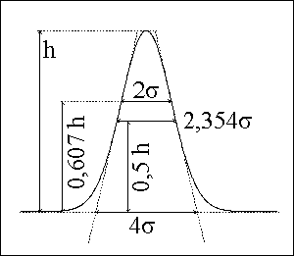
Theory of Chromatography
Efficiency of chromatography
Efficiency is related experimentally to a solute’s peak width.
  An efficient system will produce narrow peaks
  Narrow peaks ≈ smaller difference in interactions in order to separate two solutes
Efficiency is related theoretically to the various kinetic processes that are involved in solute retention and transport in the column
  Determine the width or standard deviation (σ) of peaks
  Estimate (σ) from peak widths, assuming Gaussian shaped peak:
  W_{b} = 4σ
  W_{h} = 2.354σ

Slide 24
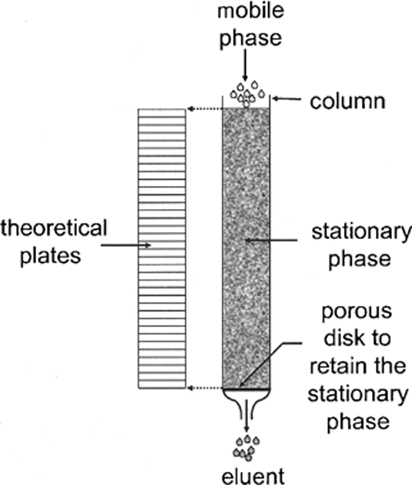
Theory of Chromatography
Number of theoretical plates (N):
Compare efficiencies of a system for solutes that have different retention times:
Gaussian shaped peak:
The larger the value of N is for a column, the better the column will be able to separate two compounds:
The better the ability to resolve solutes that have small differences in retention.
N is independent of solute retention
N is dependent on the length of the column

Slide 25
Theory of Chromatography
Plate height or height equivalent of a theoretical plate (H or HETP):
Compare efficiencies of columns with different lengths:
L = column length
N = number of theoretical plates for the column
Note: H simply gives the length of the column that corresponds to one theoretical plate.
H can be also used to relate various chromatographic parameters (e.g., flow rate, particle size, etc.) to the kinetic processes that give rise to peak broadening.

Slide 26
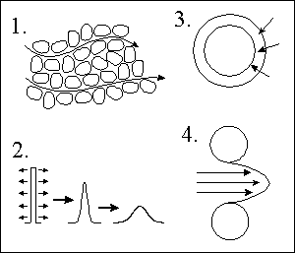
Theory of Chromatography
Why Do Bands Spread?
Eddy diffusion – different molecules have to travel different distance
Longitudinal diffusion – molecules move from the place with higher concentration to place with lower concentration
Stationary phase mass transfer – different depth of molecules diffusion into the stationary phase particle.
Mobile phase mass transfer – diffusion asociated with different mobile phase velocity

Slide 27
Theory of Chromatography
Rate Theory of Chromatography
The HEPT height depends on mobile phase velocity (u):
H = H_{L} + H_{S} + H_{M} + H_{SM}
H Plate equivalent to the theoretical plate (as in Plate Theory)
H_{L} Contribution to the longitudinal diffusion
H_{S} Stationary phase mass transfer contribution
H_{M} Diffusion associated with mobile phase effect
H_{SM} Diffusion into or mass transfer across a stagnant layer of mobile phase
Van Deemter equation

Slide 28
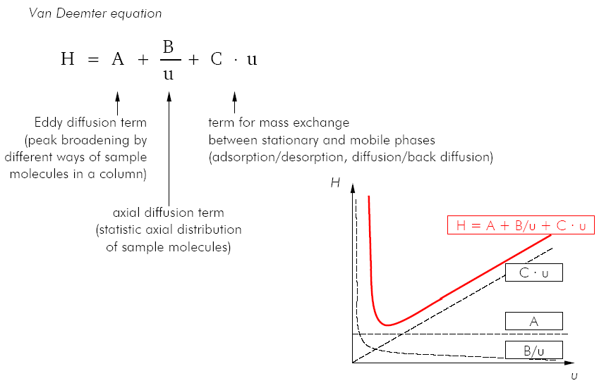
Theory of Chromatography

Slide 29
Theory of Chromatography
Separation factor
Universal measure of retention, determined from t_{R} or V_{R}:
k‘₍₁₎ – capacity factor of solute 1
k‘₍₂₎ – capacity factor of solute 2, when k‘₍₂₎ > k‘₍₁₎
A value of α > 1.1 is usually indicative of a good separation Does not consider the effect of column efficiency or peak widths, only retention.
t_{R(2)}
Component 2
signal
t_{R(1)}
Component 1
t₀
time (t)

Slide 30
Theory of Chromatography
Resolution (R_{S}):
Resolution between two peaks is a second measure of how well two peaks are separated:
t_{r1}, W_{b1} retention time and baseline width for the first eluting peak
t_{r2}, W_{b2} retention time and baseline width for the second eluting peak
t_{R(2)}
Component 2
signal
R_{S} is preferred over α since both retention (t_{r}) and column efficiency (W_{b}) are considered in defining peak separation.
t_{R(1)}
Component 1
t₀
W_{b(1)}
W_{b(2)}
time (t)

Slide 31
Theory of Chromatography
Factors affecting resolution
Selectivity expressed as Separation factor (α)
Retention of later eluted compound expressed as Capacity factor (k‘)
Efficiency expressed as number of effective plates (N)
Selectivity term
Type of stationary phase
Used mobile phase
Solubility of analysed compounds in mobile phase
Retention term
Elution strenght
Type and amount of stationary phase
Temperature
Efficiency term
Column lenght
Particle size

Slide 32
Theory of Chromatography
Factors affecting resolution
Selectivity and column efficiency
Good selectivity
Good efficiency
Signal
Signal
Time
Time
Poor selectivity
Poor efficiency
Signal
Signal
Time
Time

Slide 33
Chromatographic systems
Increasing polarity
Water-insoluble
Water-soluble
Selection of chromatographic configuration depends on physico-chemical properties of the analyte:
Analyte solubility
Analyte polarity
Analyte weight
Non-polar
Ionic
Non-ionic polar
10²
Partition
(Reversed phase partition)
(Normal phase partition)
Adsorption
Ion
exchange
10³
Normal phase LC
HILIC
Reversed phase LC
Ion exchange
10⁴
Molecular weight
Only weak interactions with stationary phase are required
(analytes have to go throught the column)
Exclusion
10⁵
(Gel permeation)
(Gel filtration)
10⁶

Slide 34
Chromatographic systems
Selection of chromatographic configuration:
 | Normal phase Chromatography | Reversed Phase Chromatography | HILIC Chromatography | Ion Exchange Chromatography
Stationary phase | Polar (silica, alumina, florisil, MgO) | Non-polar modified silica (CN, C8, C18, phenyl) | Polar (silica, modified silica (aminopropyl, CN)) | Ionic (Resins with bonded ionic groups
Mobile phase | Non-polar (hexan, dichlormethan, tetrahydrofuran, ethylacetate) | Polar (water, methanol, acetonitrile, tetrahydrofuran) | Polar (water, acetonitrile) | Ionic water (up to 50% organic) with buffers (NaHCO3, NaOH…)
Analytes | Non-polar and water insoluble | Non-polar and polar | Ionic and non-ionic polar, water soluble analytes | Ionic, organic and anorganic bases and acids

Slide 35
HPLC System
Columns and Stationary Phases
Stationary phases
IONIC
HYDROPHOBIC
POLAR
SCX
SAX
F5
NH₂
Silica
CN
Phenyl
C₄
C₈
C₁₈
SCX…strong cation exchange
SAX…strong anion exchange
Silica …bare silica phase
CN…cyanopropyl phase
NH₂…amino phase
F5…pentafluorophenyl phase
Phenyl…butyl-phenyl phase
C₄…butyl phase
C₈…octyl phase
C₁₈…octadecyl phase

Slide 36
Normal Phase Chromatography
Adsorption chromatography, -OH on the surface of silica are active sites (or Al³⁺ an O²⁻ in case when alumina is used).
Types of interactions are dipole-induced dipole, dipole-dipole, hydrogen bonding, π-complex bonding.
Adsorption strengths (k) increase in the following order:
  saturated hydrocarbons < olefins < aromatic ≈ halogenated compounds < suphides < ethers < nitro compounds < esters ≈ aldehydes ≈ ketones < alcohols ≈ amines < suphones < suphoxides < amides < carboxylic acids
Only functional groups or double bond are used for separation, it is not possible to distinguish between molecules that are identical except the aliphatic moiety.
The most polar functional group in the molecule determines its retention.
The strength of interaction depends also on steric factors, isomers are suitable for separation by adsorption chromatography.

Slide 37
Normal Phase Chromatography
Lipophilicity
Polar compounds are eluted later than the non-polar.
1
2
3
1
2
3
2
signal
3
1
1
2
3
void
1
2
3
time
Polarity

Slide 38
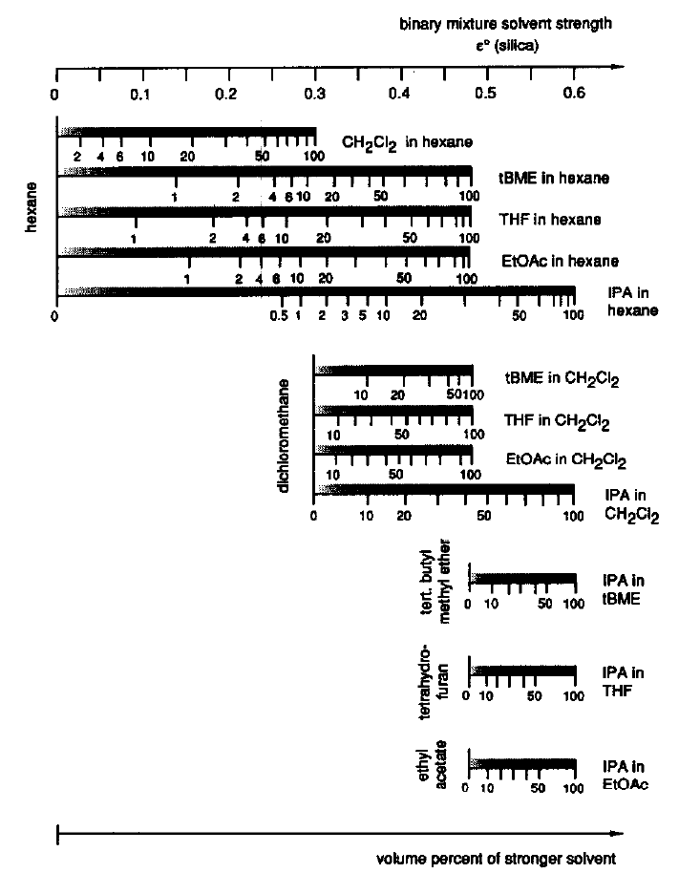
Normal Phase Chromatography
Elution strength of binary mixture
Elution strength of the various solvents is determined empirically (ε°).
Same elution strength could be achieved with solvents of different selectivity.

Slide 39
Reversed Phase Chromatography
Partition type of chromatography
Main type of interaction is hydrophobic (van Der Waals interaction), but in real is the retention mechanism complex.
Elution order:
  Strong Lewis acids (carboxylic acids) < Weak Lewis acids (alcohols, phenols) < Strong Lewis bases (amines) < Weak Lewis bases (ethers, aldehydes, ketones) < permanent dipoles (CHCl₃) < induced dipoles (CCl₄) < aliphatics
Retention increases also with the number of carbon atoms in molecule:
… Pentan < Hexan < Heptan…
Branched-chain isomers are eluted earlier than linear form.

Slide 40
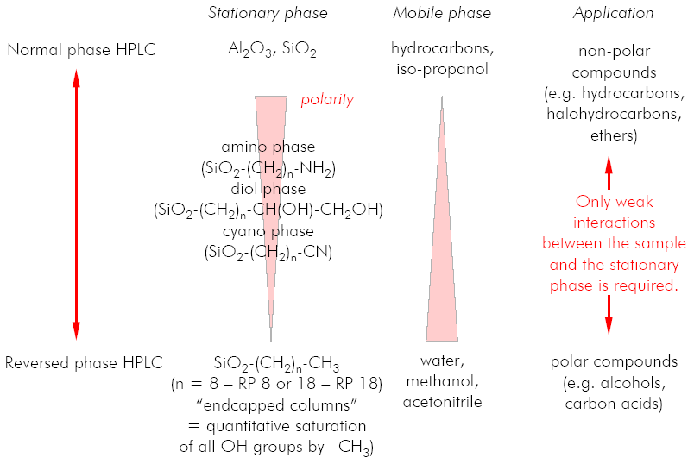
Reversed Phase Chromatography
Comparison of normal and reversed phase chromatography

Slide 41
Reversed Phase Chromatography
Lipophilicity
Polar compounds are eluted earlier than the non-polar.
3
2
1
3
2
1
2
3
2
1
signal
3
1
3
2
1
void
time
Polarity

Slide 42
Reversed Phase Chromatography
Mobile phase selection in RP-HPLC
Mobile phase generally consist of mixtures of water and water-miscible organic solvent:
Methanol
Acetonitrile
Ethanol
Isopropanol
Dimethylformamide
Propan-1-ol
Dioxane
Tetrahydrofuran
Decreasing polarity
Increasing elution power
Non-aqueous eluents are used in RP-HPLC for elution of highly non-polar compounds.
The mixtures with water have higher viscosity (produced higher back pressure) than the pure solvents.

Slide 43
Reversed Phase Chromatography
Mobile phase selection in RP-HPLC
Polarity is only one parameter to change separation.
Another parameter is selectivity:
Selectivity term
Polarity term
Not all solvents could be used (possible chemical interaction, miscibility issue, toxic, flammable, volatile).

Slide 44
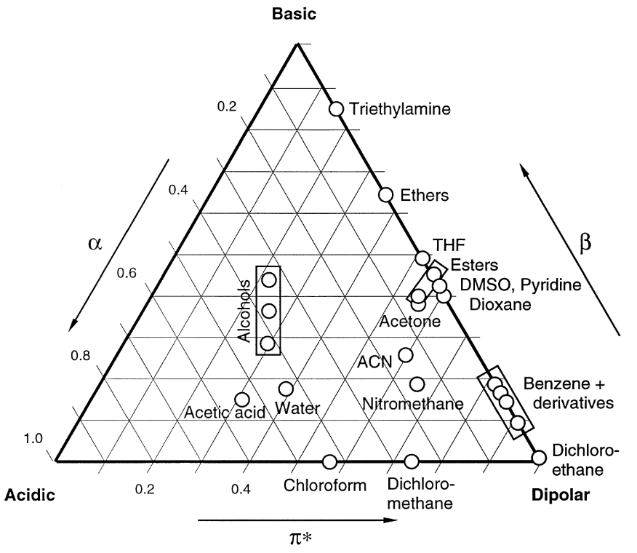
Reversed Phase Chromatography
Mobile phase selection in RP-HPLC
Triangle of selectivity
Comparison of different solvents in terms of their dipolar (π), acidic (α) and basic (β) properties.
Largest difference in selectivity could be expected for solvents with the most different properties.

Slide 45
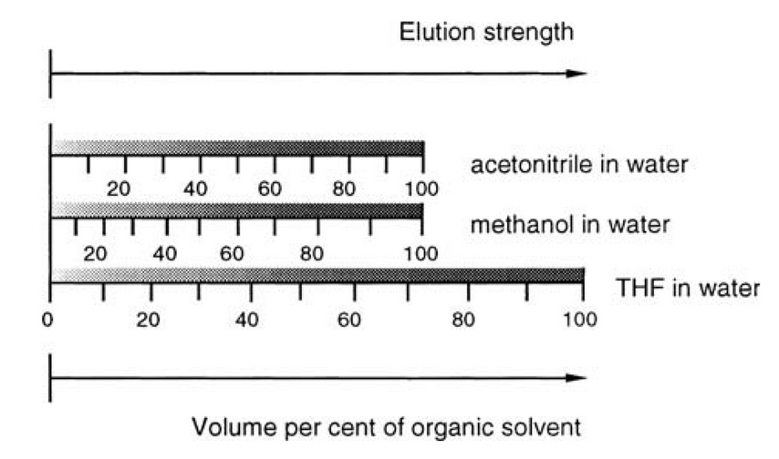
Reversed Phase Chromatography
Common solvents in RP-HPLC
Methanol – acids
Acetonitrile – bases
Tetrahydrofuran – strong dipole
Water – polarity adjustment
Miscible
Low viscosity
Available in the highest purity
Cheap

Slide 46
Reversed Phase Chromatography
Stationary phases
C18 modified silica is the most common stationary phase, providing high retention (other phases are C8, phenyl, CN, diol, NH2 – providing lower retention and alternative selectivity).
Carbon load: Retention strenght for C18 could be estimated from „carbon load“ – more carbon means thicker stationary phase and consequebntly higher retention (for non-polar analytes, columns with lower carbon load could be recommended).
Pore size (Å, Ångström) determines suitability of the phase for small or large molecules – small pore size providing better capacity, but it is not for large molecules molecules.
1Å = 0.1 nm (1×10⁻¹⁰ meter)
Silanol activity – it is not possible to derivatize all silanols for sterical reasons. Silanol groups could be endcapped or shielded stericaly. Silanol activity provides different selectivity of the column.

Slide 47
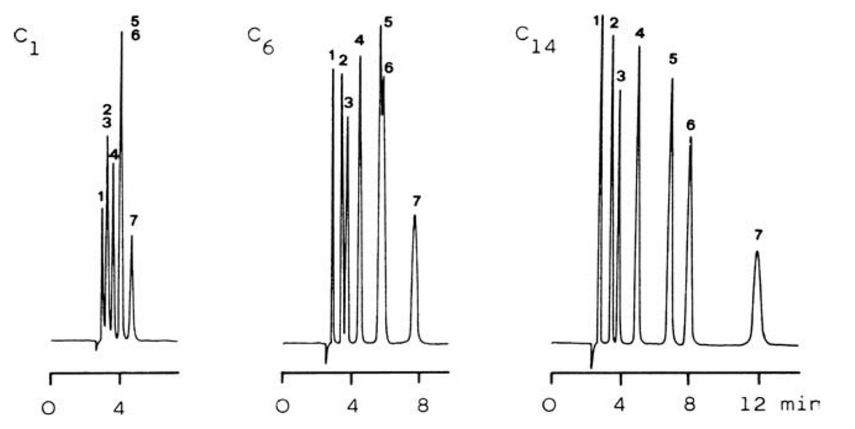
Reversed Phase Chromatography
Stationary phases
Effect of chain lenght on retention.
Acetone
p-methoxyphenol
Phenol
m-cresol
3,5-xylenol
Anisole
p-phenylphenol
Longer chain provides higher retention.

Slide 48
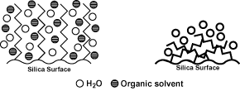
Reversed Phase Chromatography
Stationary phases
Separation of the most polar compounds needs water-rich mobile phase.
Since high hydrophobicity of C18 phase, such mobile phase can colapse.
H₂O
Organic solvent
Normal conditions, the solvents and sample have full acces to the stationary phase.
Collapsed phase due to high water mobile phase.
New phases developed for separation of polar compounds and 100% water mobile phase compatibility.

Slide 49
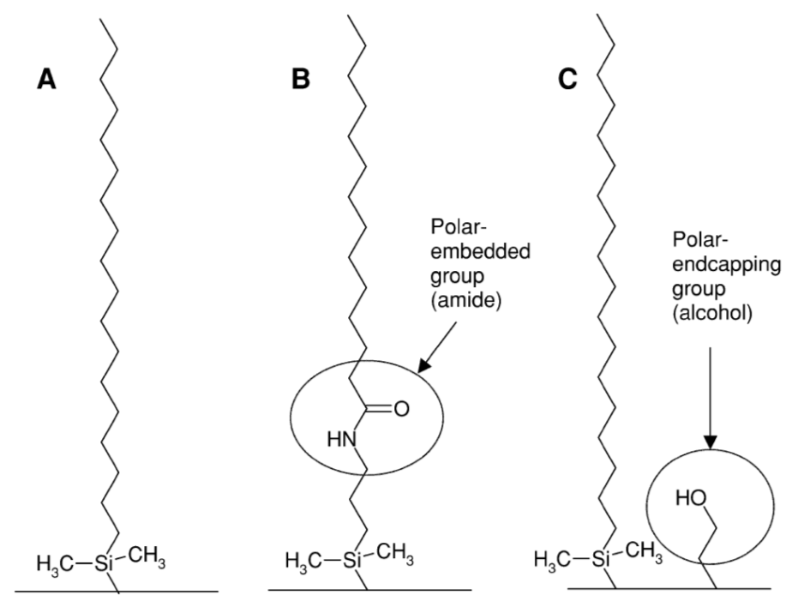
Reversed Phase Chromatography
Stationary phases
Introduction of polar (hydrophilic) groups stabilise the stationary phase even 100% water mobile phase is used.
Polar-encapped phase – Hydrophobic interaction silmilar to the traditional phase, stronger hydrogen bonding and silanol activity.
Polar-embedded phase – Opposite behaviour, reduction of the hydrophobic intercation, reduced silanol activity.
Common C18 phase
C18 + polar-embedded group
C18 + polar-encapping

Slide 50
Reversed Phase Chromatography
Separation of ionic compounds
Ionic compounds should be analysed in the non-dissociated forms by adjusting pH.
Use acidic mobile phase for acid analysis and basic mobile phase for bases.
  pH should be 2 units above or under the analyte pK_{A}.
For separation of basic compound, special endcapped or shielded phases with low silanole activity should be used.
pH should be in the operation range of the column (usually pH 2-7)
  Stationary phase is hydrolysed at low pH.
  Silica support is hydrolysed at high pH.

Slide 51
Reversed Phase Chromatography
Separation of ionic compounds
Free silanol groups are charged in pH > 4. Except the hydrophobic, also ion exchange separation mechanism is employed and it can cause tailing of basic analytes (acids are not influenced).
Atack sites at low pH
Hydrolysis at high pH
Acidic
Neutral
Basic

Slide 52
Reversed Phase Chromatography
Separation of ionic compounds
Special stationary phases were developed to improve low pH column stability.
The Si-C bond is sterically protected.
HYDROLYTICALLY UNSTABLE
CONVENTIONAL
HYDROLYTICALLY STABLE
STERICALLY PROTECTED

Slide 53
Reversed Phase Chromatography
Separation of ionic compounds - acids
pH decreasing
pKA < pH
pKa ≈ pH
pKa > pH
Dissociated (polar) analyte provides poor retention and peak shape.
At pH similar to analyte pKa both, disociated and non-disociated forms are present. The peak is splitted and wide.
WORST CASE!
Non-disociated analyte provide better retention and good peak shape.
Sensitivity in ESI- conditions (polarity in which most acids provide ions) could be lowered, when low pH mobile phase is used.

Slide 54
Reversed Phase Chromatography
Separation of ionic compounds - bases
pH increasing
pKa > pH
pKa ≈ pH
pKa < pH
Highly polar (dissociated) analyte provides poor retention and peak shape.
At pH similar to analyte pKa both, disociated and non-disociated forms are present, also ion interaction causes peak tailing. The peak is splitted and wide.
WORST CASE!
Non-disociated analyte provide better retention weak ion interaction still plays role (peak slightly tails).
Sensitivity in ESI+ conditions (polarity in which most bases provide ions) could be lowered when high pH mobile phase is used!

Slide 55
Reversed Phase Chromatography
Separation of ionic compounds – Ion-Pair Chromatography
Method of choice, when neutral and ionic compounds have to be analysed togehter.
Reversed-phase chromatography with counter ion in mobile phase (neutral compounds are not influenced).
+
&
-
+
-
Analyte
Counter ion
Ion-pair
Ion-pairs are separated as neutral molecules.
-
&
+
-
+
Analyte
Counter ion
Ion-pair

Slide 56
Reversed Phase Chromatography
Separation of ionic compounds – Ion-Pair Chromatography
Common ion-pair agents:
Counter ion | Suitable for
Quarternary amines (tetramethylammonium, tetrabutylammonium, palmityltrimethylammonium) | Strong and weak acids, suphonated dyes, carboxylic acids
Tertiary amines (trioctylamine) | Sulphonates
Alkyl- and arylsulphonates (methanesulphonate, heptanesuphonate) | Strong and weak bases, benzalkonium salts, catecholamines.
Perchloric acids | Strong ion pairs with basic compounds
Perfluoric acids | Strong ion pairs with basic compounds
Ion-Pair chromatography is not suitable for LC-MS applications, since stable ion-pairs do not provide ions and sensitivity is significantly compromised.

Slide 57
HILIC
HILIC – Hydrophilic Interaction Chromatography
  Term coined in 1990 to distinguish from normal-phase
HILIC is a variation of normal-phase chromatography without solvents that are not miscible in water. Also called „Reversed reversed-phase“ or „Aqueous normal-phase“.
Stationary phase is POLAR: Silica, cyano, amino, diol
The mobile phase is highly organic (> 80%) with a smaller amoutn of aqueous mobile phase.
  Water (or the polar solvent) is the strong, eluting solvent.

Slide 58
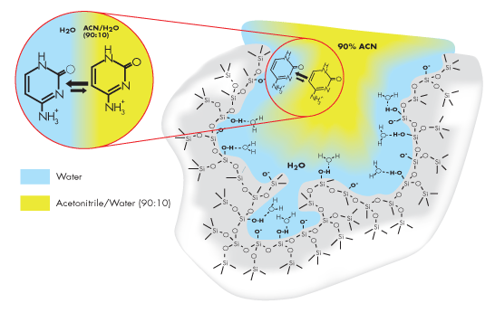
HILIC
Principle of retention
Polar analyte partitions into and out of adsorbed water layer.
Charged polar analyte can undergo cation exchange with charged silanol groups.
Benefits of HILIC
Retention of highly polar analytes not retained by reversed-phase
Complementary selectivity to reversed phase
Enhanced sensitivity in mass spectrometry
  High organic mobile phase promotes enhanced ESI MS response
Shorter sample preparation, elimination of evaporation/reconstitution step by directly injecting the organic phase.

Slide 59
HILIC
Mobile phases
Phosphate buffers are not recommended due to recipitation in high organic mobile phase.
Ammoniom formate (pH 3); ammonium acetate (pH 5); 0.2% formic acid (pH 2.5), 0.2% phosphoric acid (pH 1.8).
For optimum performance and reproducibility it is recommended concentration of 10 mM buffer or 0.2% of an additive ON COLUMN.
To increase analyte retention, replace some of the water with another polar solvent (methanol, isopropanol).
Solvent strenght
Strongest
Water
Methanol
Ethanol
Isopropanol
Acetonitrile
Acetone
Tetrahydrofuran
Weakest

Slide 60
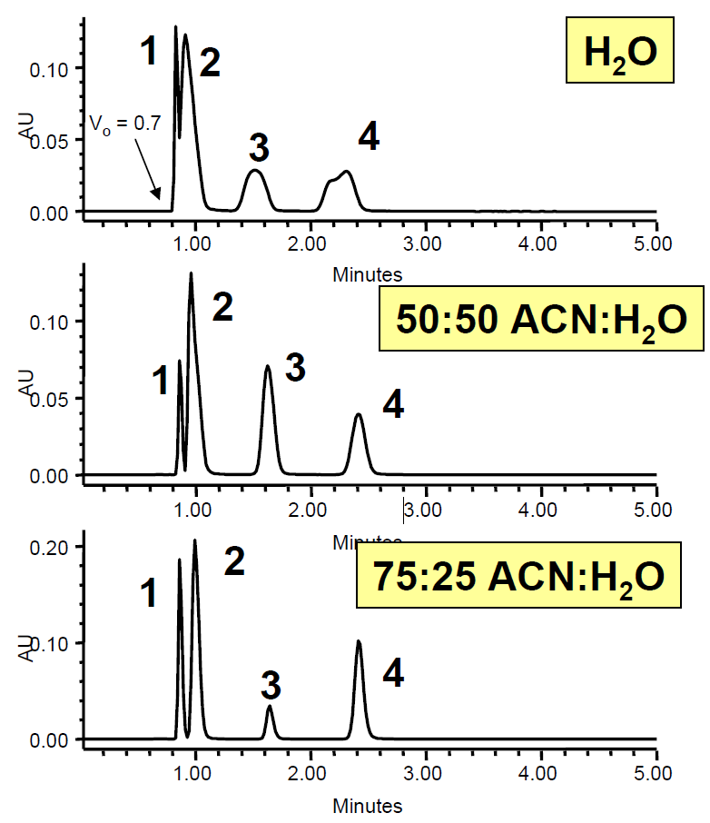
HILIC
Influence of sample dilluent on peak shape
5-Fluorouracil
Uracil
5-Fluorocytosine
Cytosine
Peak shape improves as % ACN in the diluent increases, but solubility can suffer. Replacing of the aqueous portion of the diluent with a polar solvent can solve this problem.

Slide 61
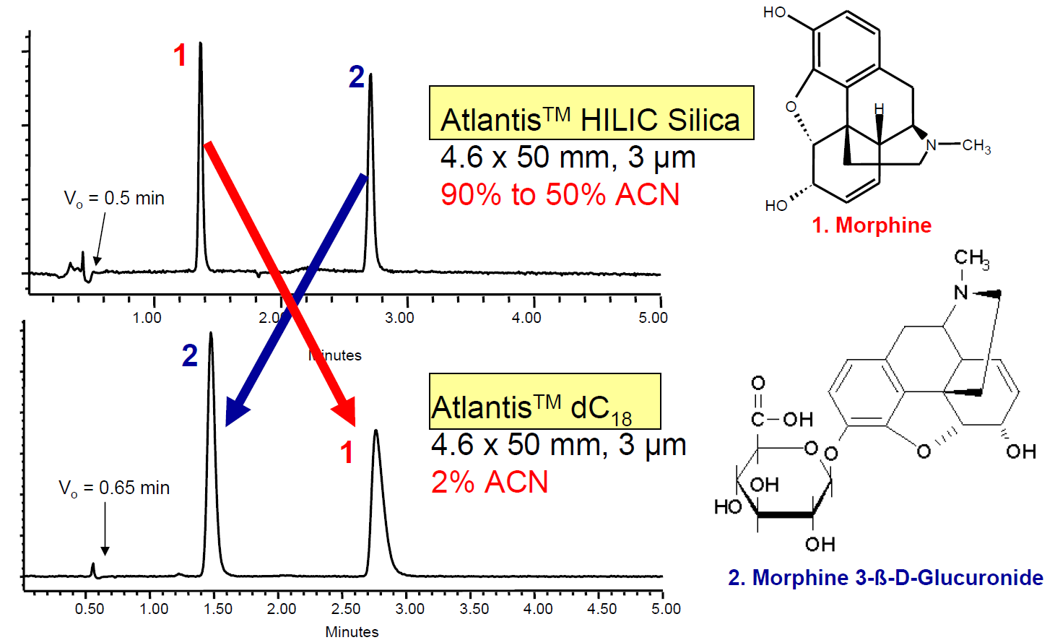
HILIC
Complementary selectivity to Reversed-Phase

Slide 62
HILIC
Example of aplication: Separation of DON and its conjugates
(apHera NH2 Polymer 150×2mm; 5μm)
DON
m/z = 355.1393 ± 0.025Da
DON-3-glucoside
m/z = 517.1921 ± 0.025Da
DON-di-glucoside
m/z = 679.2449 ± 0.025Da
DON-tri-glucoside
m/z = 841.2978 ± 0.025Da

Slide 63
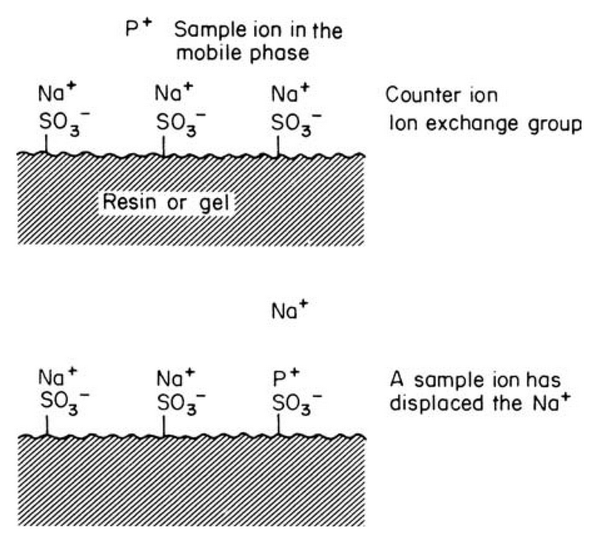
Ion-Exchange Chromatography
Principle: Similar to adsorption chromatography, the sample and the solvent molecules compete with each other for active sites.
The main principle is ionic interaction.
Stationary phase capable to retain ions: SO₃²⁻, COO⁻,NH₃⁺ or NR₃⁺
  Negatively charged sorbents interact with cations (catex).
  Possitively charged exchanger forms bond with anionts (anex).
Mobile phase usually water with couner-ion. The elution is based on increasing of ion strenth (concentration of the conter ion).

Slide 64
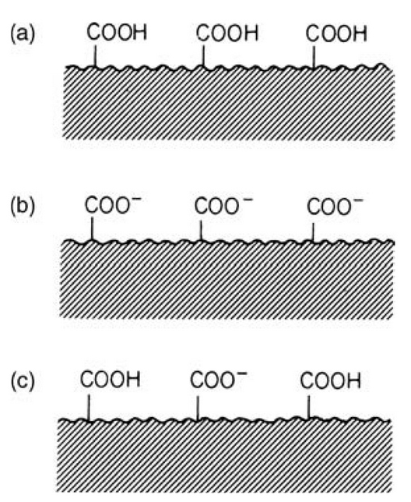
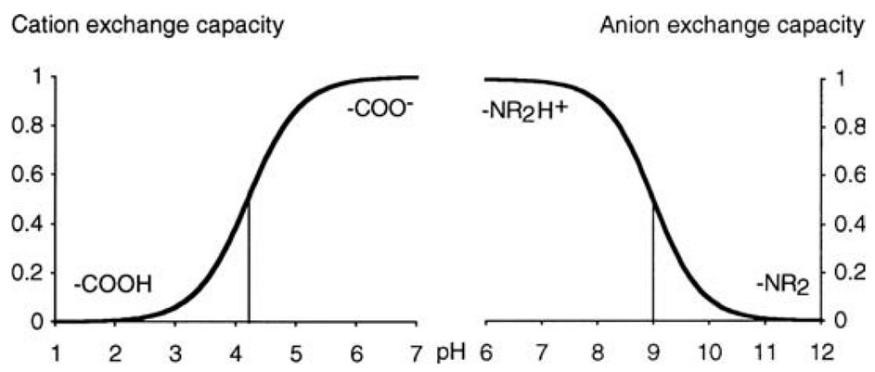
Ion-Exchange Chromatography
pH < pKa
Stationary phase:
Usually based on polymers (silica is not suitable, since very wide range of pH is used).
Strong exchangers (anion and cation) are charged over the full range pH (not affected by pH of mobile phase.
Capacity of weak exchangers is pH dependent. Only dissociated active sites can interact with analyte.
pH > pKa
pH ≈ pKa
Undissociated cation exhcanger
Dissociated cation exchanger
Partly dissociated cation exchanger
Profile of capacity for cation exchange and anion exchange.

Slide 65
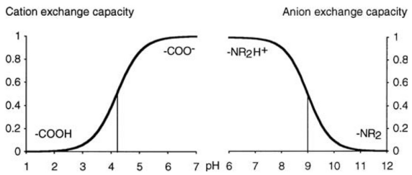
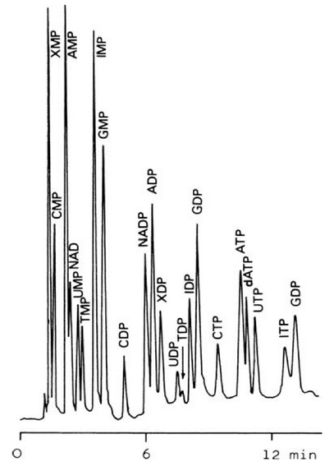
Ion-Exchange Chromatography
Mobile phase:
Mobile phase usually consist from water (up to 50% of organic) with couner-ion.
Retention is decreased with higher mobile phase ion strength (concentration of the conter ion).
  An increase in pH reduces retention time in cation exchange.
  Conversly, an decrease in pH reduces retention time in anion exchange.
Applications
Weak exchangers are used for separation of the strong ions, strong exchangers for separation of weak ions.
Analysis of very polar pesticides (glyphosate, ethephone, quarternary amines)
Separation of biomolecules
Separation of 22 nucleotides and reated compounds by anion exchange.

Slide 66
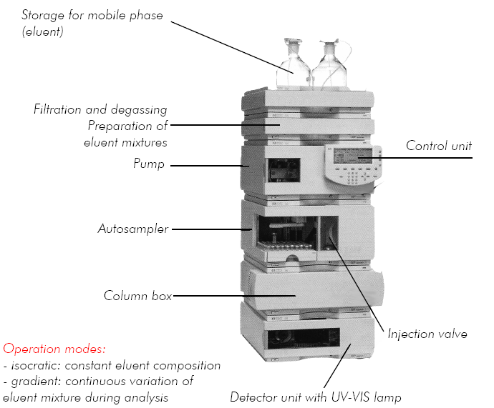
HPLC system

Slide 67
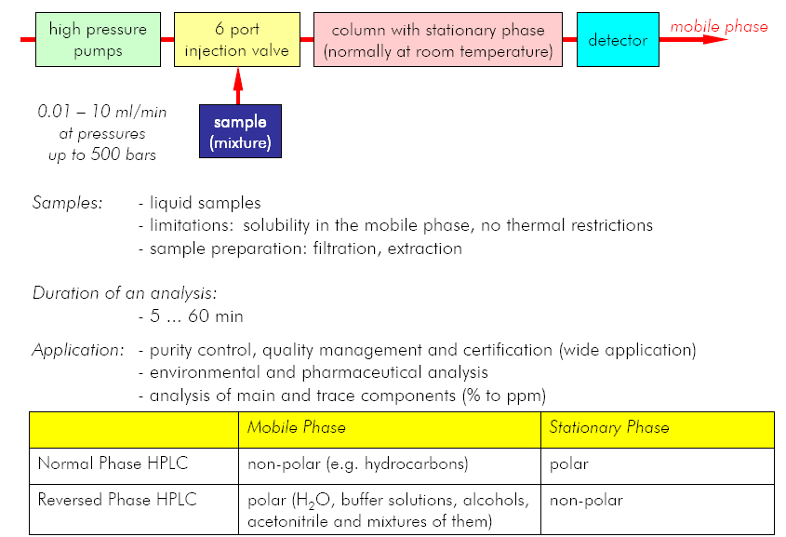
HPLC System

Slide 68
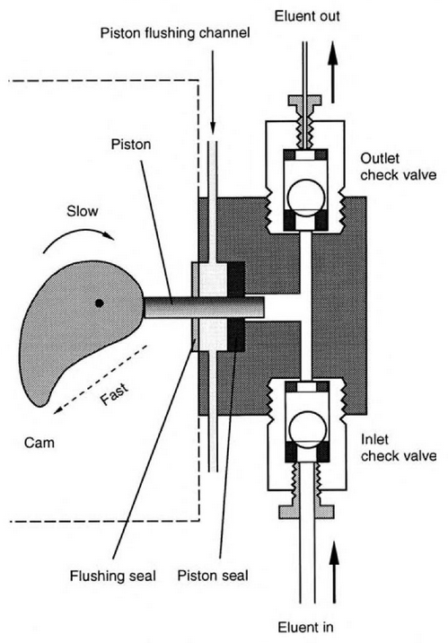
HPLC System
Pumps
Requirements:
Stable flow rate in the range 0.05 – 2 (5) ml/min.
Generating high pressure up to 1000 bar.
Pressure ripple less than 0.5 %.
The Short-Stroke Piston piump
The Cam guides the piston to its forward and backward direction.
Irregular shape of the Cam causes fast filling of the piston and the slow delivery period.

Slide 69
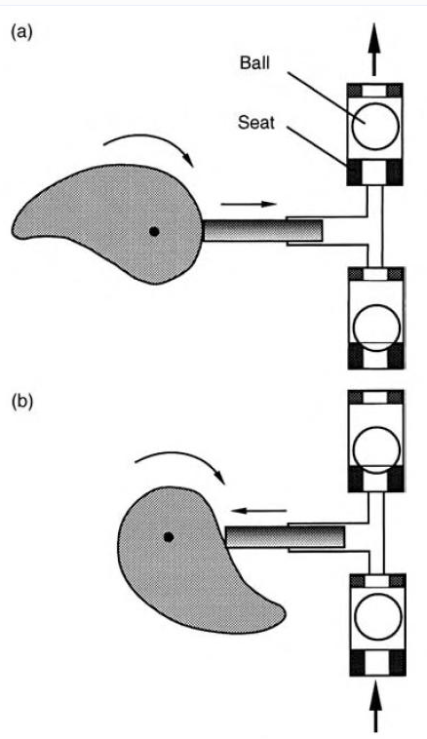
HPLC System
Pumps
Tandem piston pump:
Current design of HPLC and UHPLC pumps.
Combination of two strokes, the first fills the second stroke
The flowrate is smooth as much as possible.
Compensation of mobile phase compresibility.
Suppress cavitation (formation of bubbles during piston filling).
Delivery stroke
Filling stroke

Slide 70
HPLC System
Gradient systems
Mobile phase reservoirs
Quarternary pump (quarternary gradient, low pressure gradient)
Mixing of up to 4 different solvents
Cheaper instrumentation (one degasser, one pump).
Higher gradient delay volume (compared with the binary pump)
Gradient is mixed in the mixer and it is based on opening of the valves.
A
B
C
D
Low pressure
Mixer
Degasser
Gradient delay
Pump
High pressure
Injection
Column

Slide 71
HPLC System
Gradient systems
Mobile phase reservoirs
Binary pump (binary gradient, high pressure gradient)
Mixing only of two solvents
Expensive, sofisticated instrumentation (two degassers, two pumps, control unit for pump synchronization).
Very small gradient delay.
Superb gradient reproducibility.
Gradient is achieved by controll of flow rate of the pump.
A
B
Low pressure
Degasser
Degasser
Pump A
Pump B
High pressure
Mixer
Gradient delay
Injection
Column

Slide 72
HPLC System
Injection – six port valve
Sample load
Sample inject
Sample loop
Sample loop
To column
To column
From pump
From pump
Needle
Needle
Syringe
Syringe
Sample
Sample

Slide 73
HPLC System
Column
Column is the most important for chromatographic separation:
Stationary phase selection depends on sample/analyte properties (solubility, polarity, etc.)
Factors for the selection of appropriate column and sorbent:
Separation efficiency, peak symetry
Column lifetime, stability of the bonded phase
Reproducibility
Time of analysis
Selectivity
Column lenght:
Resolution
Separtion efficiency
Back pressure
Mobile phase consumption
Analysis time
Column diameter:
Back pressure
Mass sensitivity
Separtion efficiency
Column capacity
Mobile phase consumption
Decrease with diameter
Increase with lenght
Increase with diameter

Slide 74
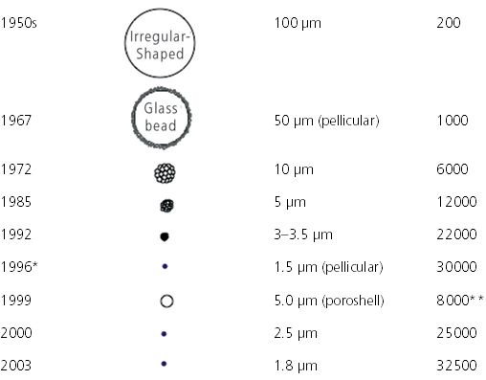
HPLC System
Columns and Stationary Phases
History of the HPLC particles development
Year
Particle size
Number of plates (15 cm)
Particle parameters:
Size (diameter),
Shape (regular, irregular)
Type (porous, non-porous)
  Pore diameter
Active surface area

Slide 75
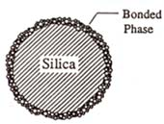
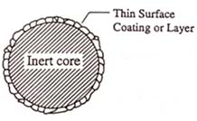
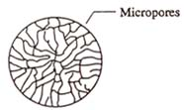
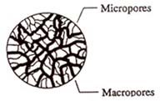
HPLC System
Columns and Stationary Phases
Types of particles
Bonded Phase Silica
Silica bead containing silanol (Si-OH) are bonded with hydrocarbon groups.
The nature of the bonded phase determines the chromatographic behavior.
Pellicular Packing
An inert core provides physical support
A thin layer of coating on the core provides functional groups for the separation of analytes
Microporous
Gel-type resin consisting of cross-linked polymers
Macroporous
Highly cross-linked (>50%) resin
Stable from pH 1 to 14
Available in a variety of particle and pore sizes

Slide 76
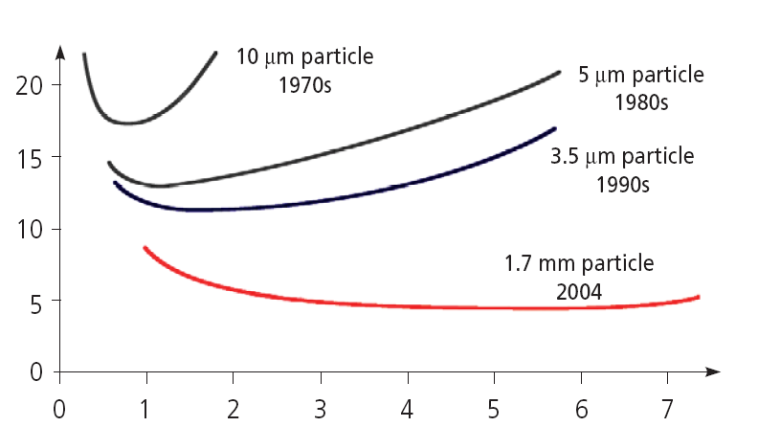
HPLC System
Columns and Stationary Phases
Particle size and separation efficiency
Smaller particle diameter allows to achieve more separation plates
Back pressure significantly increase when small particles are used.
Flow rate significantly influeneces the column efficiency and analysis time.
Columns with small particles provides optimal separation in the wide range of flowrate, which allows to use higher flowrates.
HETP (µm)
Linear velocity (cm/s)

Slide 77
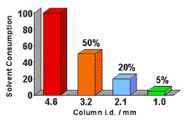
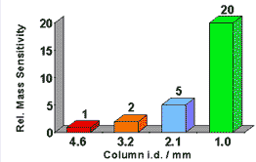
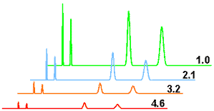
HPLC System
Columns and Stationary Phases
Solvent consumption:
Use of narrow column lead to the significant reduction of mobile phase consumption.
Mass sensitivity
Narrow column provides higher sensitivity (with the same injection volume).
Injection of 1 µl of hydrocarbon mixture on columns with different diameter.

Slide 78
HPLC System
Detection
The ideal detector should:
either be equally sensitive to all eluted peaks (universal) or record only those of the interest (selective).
not be affected by changes in temperature or in mobile phase composition (gradient elution).
be able to monitor small amounts of compound (trace analysis).
not contribute to band broadening, hence the cell volume should be small.
react quickly to pick-up correctly narrow peaks which pass rapidly through the cell.

Slide 79
HPLC System
Detection
Concentration or Mass sensitive:
Concentration-sensitive detectors produce a signal, which is proportional to the concentration of the sample in the eluate.
Mass-sensitive detectors produce signal which is proportional to tha mass flux (number of molecules or ions per unit time).
Selectivity
Non-selective detectors react to the bulk property of the solution passing through (Refractive index detector, RID, conductivity detector).
Selective detectors utilizing specific properties of the compound (UV/VIS absorbance, fluorescence, redox potential, mass-to-charge ratio).

Slide 80
HPLC System
Detection
HPLC detectors:
 | Detector | Selectivity | Sensitivity | Merits
Optical detection | UV/UV-VIS detector | 2 | 3 | A wide variety of substances can be detected that absorb light from 190 to 900 nm. Sensitivity depends strongly on the component.
 | Diode array detector (DAD, PDA) | 2 | 3 | A wide variety of substances can be detected that absorb light from190 to 900 nm. Sensitivity depends strongly on the component. The spectrum can be confirmed for each component.
 | Fluorescence (FL) detector | 3 | 4 | Components emitting fluorescence can be detected selectively with high sensitivity. This is often used for pre-column and post-column derivatization.
 | Differential refractive index (RI) detector | 1 | 1 | Any component that differs in refractive index from the eluate can be detected, despite its low sensitivity. Cannot be used to perform gradient analysis.
 | Evaporative light scattering detector (ELSD) | 1 | 2 | This detector atomizes the column eluate, and detects the scattered light of the resulting particulate components. Non-UV-absorbing components are detected with high sensitivity.
Electrical detection | Conductivity detector (CD) | 2 | 3 | Ionized components are detected. This detector is used mainly for ion chromatography.
 | Electrochemical detector (ECD) | 3 | 4 | Electric currents are detected that are generated by electric oxidation-reduction reactions. Electrically active components are detected with high sensitivity.
 | Corona® Charged Aerosol Detector® (Corona® CAD®) | 1 | 3 | This detector atomizes the column eluate and electrically detects the resulting particulate components treated with corona discharge. UV-nonabsorbing components can be detected with sensitivity higher than that of ELSD.

Slide 81
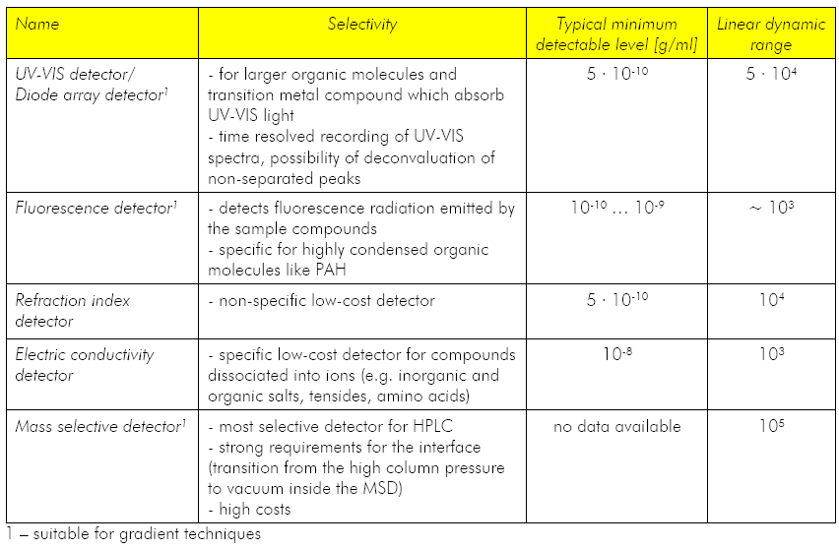
HPLC System
Detection
HPLC detectors:

Slide 82
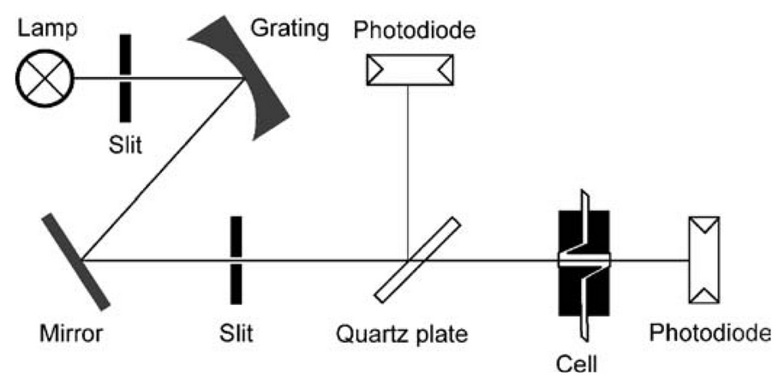
HPLC System
Detection – UV/VIS
The most common detection technique HPLC detector.
Detection of bromine, iodine, sulphur, carbonyl group, nitro group, conjugated double bonds, aromatic ring…etc.
UV/VIS detector:

Slide 83
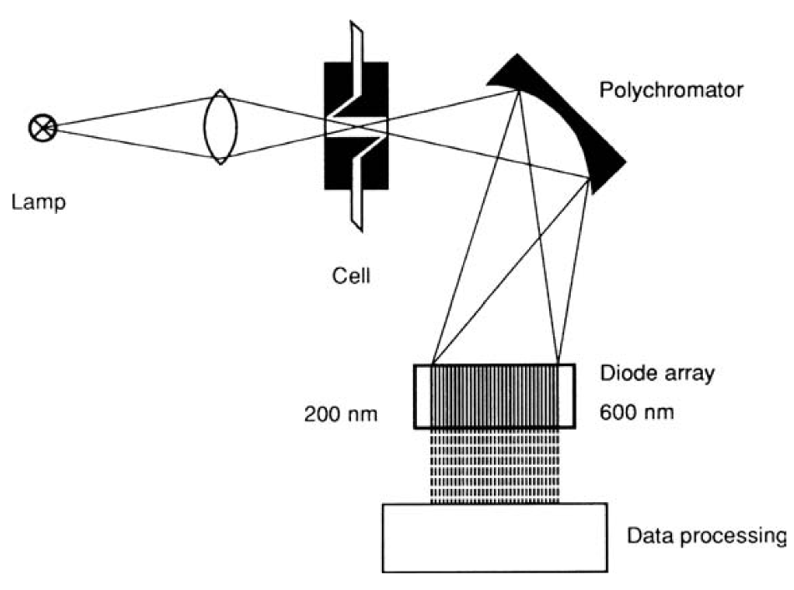
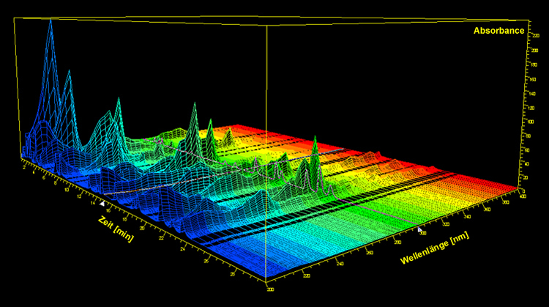
HPLC System
Detection – Diod array detector (DAD)
Improved version of UV/VIS, full absorption spectrum.
Detection of the same analytes.
Diod array detector:

Slide 84

HPLC System
Detection – Refractive index detectors
Approx 1000× less sensitive than UV detectors.
Incompatible with gradient elution, sensitive on temperature.
Detection based on the refraction of light in solution.
Two types of construction – Deflection refractometer and Interferometer.
Deflection refractometer:
When pure mobile phase is in measuring cell, the zero-glass is adjusted to direct the light on to the photodiode.
Change of refrafctive index in measuring cell deflect the light beam and it decreases resistivity of the photodiode

Slide 85

HPLC System
Detection – Refractive index detectors
Interferometer:
10× more sensitive than the deflection refractometer.
The light passes through beam splitter and is divided into two beams of equal intensity, one passes through reference cell and the second through measuring cell. Two beams are superimposed in a second beam splitter.
If refractive index in measuring cell is changed, the beams are not moving in the same velocity and are partly extinguished in the second beam splitter.

Slide 86

HPLC System
Detection – Fluorescence detector
Fluorescence is the emission of light by a substance that has absorbed light or other electromagnetic radiation of a different wavelength. In most cases, emitted light has a longer wavelength, and therefore lower energy, than the absorbed radiation.
Approx 1000× MORE sensitive than UV detectors.
Very specific and selective.
Compouns without fluorescence could be derivatized.
Light of the suitable wavelenght is passed through the cell and the longer wavelenght radiation emitted is detected in right-angled direction.

Slide 87

HPLC System
Detection – Evaporative Light Scattering Detector (ELSD)
Non-selective detection of non-volatile analytes.
The elueate is nebulized in a stream of gas (nitrogen), the droplets are then evaporated, thus producing solid particles which are passed through a laser beam. The scattered lighet is registering by photodiode.
Mobile phase must be volatile (including buffers and additives).

Slide 88
LC-MS method development
Different to compare with „traditional“ HPLC:
Suitable buffers and solvents are limited.
pH adjustment can influence ionization process (bases do not ionize in high pH, acids in low pH).
Selectivity is provided by MS instrument.
Non-intereferring matrix could cause „matrix effects“ (ion suppression or ionization enhancement), problematic quantitation.
High water mobile phase decrease MS sensitivity.
Some ionic compounds (Na⁺, HCOO⁻, Cl⁻) provide strong adducts with analyte, not allowing further MS/MS fragmentation.

Slide 89
LC-MS method development
Is the analyte polar?
yes
Is it retained by RP?
Is it retained by HILIC?
Use HILIC
no
yes
no
yes
no
Is it eluted by RP?
Use Reversed phase
Is it base?
yes
no
no
yes
Use Normal Phase.
Use anion exchange
Use cation exchange

Slide 90
LC-MS method development
Mobile phase
Volatile buffers and acids (ammonium acetate, ammonium formate, volatile quarternary amines, formic acid, acetic acid, trifluoracetic acid).
Water with resistivity 18 MΩ (without any ions).
Highest purity of all solvents (HPLC or LC-MS grade).
Solvents have to be compatible with the ion-source:
 | Electrospray ionization (ESI) | Atmospheric pressure chemical ionization (APCI) | Atmospheric pressure photo ionization (APPI)
Analyte | Polar, ionic | Polar, non-polar | Aromatic, conjugate double bonds, non-polar
Mobile phase | Water, Methanol, Acetonitrile, Tetrahydrofuran | Water, Methanol, Acetonitrile, Tetrahydrofuran, Ethylacetate, Toluene | Water, Methanol, Acetonitrile, Tetrahydrofuran, Ethylacetate, Toluene, Hexane
Chromatographic system | Reversed phase, HILIC, Ion-Exchange | Reversed Phase, Normal Phase | Reversed Phase, Normal Phase

Slide 91


LC-MS method development
Gradient optimization
Baseline separation of all analytes in multi-analyte methods is not required (possible). The functions of gradient are different:
  Separation of the analytes to detect only limited analytes at once.
  Separation of the matrix co-extracts to minimize matrix effects.

Slide 92

LC-MS method development
Gradient optimization
The real gradient is always delayed after the program.
Binary pump system produces more precise gradient, the gradient delay is lower than in quarternary system.

Slide 93
LC-MS method development
Gradient optimization
Injection of strong sample diluent causes serious band broadening of less retained compounds:
100
Acetonitrile (strong diluent)
Injection: 2µl
100
Acetonitrile (strong diluent)
Injection: 3µl
100
Acetonitrile (strong diluent)
Injection: 4µl
%
%
%
0
1.00
1.50
2.00
Time
0
1.00
1.50
2.00
Time
0
1.00
1.50
2.00
Time
100
Acetonitrile (strong diluent)
Injection: 5µl
100
Water
(weak diluent)
Injection: 5µl
%
Change of dilluent
%
0
1.00
1.50
2.00
Time
0
1.00
1.50
2.00
Time

Slide 94
LC-MS method development
Gradient optimization
In multi-analyte methods is needed to inject compounds with very different physico-chemical properties (also solubility). Injection in the weakest solvent is almost impossible due to sorption of some analytes.
Decreasing analyte polarity
Change of the acetonitrile extract to the water (evaporation and reconstitution in water).

Slide 95
LC-MS method development
Gradient optimization
Possible solution is dillution of extract by water and increasing of the injection volume.
The concentration of organic in the sample have to be lower than in inital mobile phase.
Risk of matrix precipitation or analyte hydrolysis in water.

Slide 96
LC-MS method development
Gradient optimization
Chromatographic profile of the matrix (UHPLC-Time-of-flight MS detector, m/z 50-1000)
Small amount of polar co-extracts near to void volume.
Non-polar co-extracts, elution in 100% organic.
Analytes elution

Slide 97
LC-MS method development
Gradient optimization
Gradient tuning for injection of strong solvent in multi-analyte method with.
2010-02-03 pest 20
1: TOF MS ES+
100
184.019 20PPM
Linear gradient
372
Separation of non-polar compounds
%
Optimized gradient
0
Time
1.50
2.00
2.50
Linear gradient
2010-02-03 pest 15
1: TOF MS ES+
100
184.02 20PPM
Optimized gradient
826
%
0
1.00
1.50
2.00
Time
Focusing of the polar analytes
2.5× higher intensity

Slide 98
LC-MS method development
Gradient optimization
Comparison of linear and optimized gradient.
Separation takes the same time.
Signal of some analytes is improved.
No adverse effects.
Better separation of non-polar matrix reduce ion suppresion induced by coeluted matrix.
Focusing of polar analytes.

Slide 99
LC-MS method development
Summary
Before the method development use fresh, high purity solvents and flush the system.
Start in the weak mobile phase (5 or 10% of organic phase in reversed-phase chromatography). In the first phase of method development, use low pH mobile phase.
Inject sample in mobile phase to avoid band broadening. If it is not possible, try to dilute sample with water and inject higher volume or inject only small volume (2-5µl of strong solvent, depends on the column capacity).
Increase B eluent (organic) to 100% and keep it at least 3 column void volumes, to be sure, that all non-polar compounds are eluted from the column.
Column equilibration needs 5-10 column void volumes. Do not forget calculate with the void volume of the gradient pump!
Always wait for the second injection, the first injection is not reliable (column is not equilibrated properly).

