Slide 1
Material properties

Slide 2
Fluence of neutrons
Φ = Ν/ S = N / πr²
neutrons pass through the imaginary sphere in all directions

Slide 3
Expression of neutron dose and fluence
The dose coming from neutrons is often expressed in relation to the materials used in the active zone by a quantity known as dpa - displacements per atom - the number of displacements per atom. This quantity is then related to the total fluence.
Typical values for BWR are:
1.5x10²¹ n/cm2 per 1 dpa for neutron energies E>0.1MeV
0.7x10²¹ n/cm2 per 1 dpa for neutron energies E>1.0MeV
For PWR (French) it states:
dpa =6.10⁻²² x fluence for E>0.1MeV
which corresponds
1.67x10²¹ n/cm² at 1 dpa for neutron energies E>0.1MeV

Slide 4
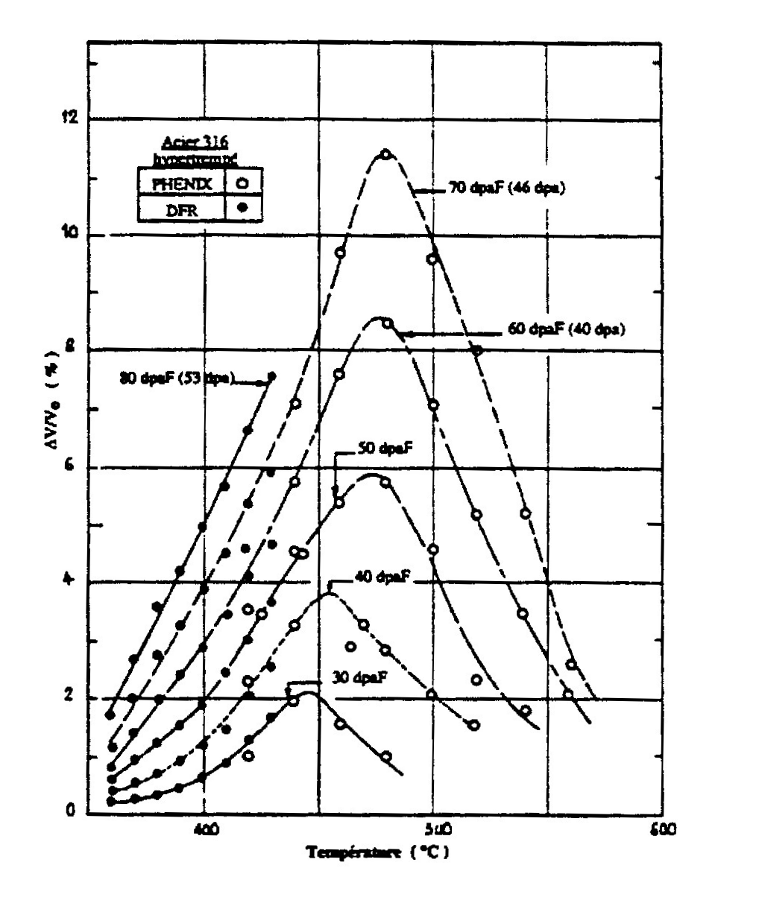
Isotropic volume expansion (swelling)

Slide 5
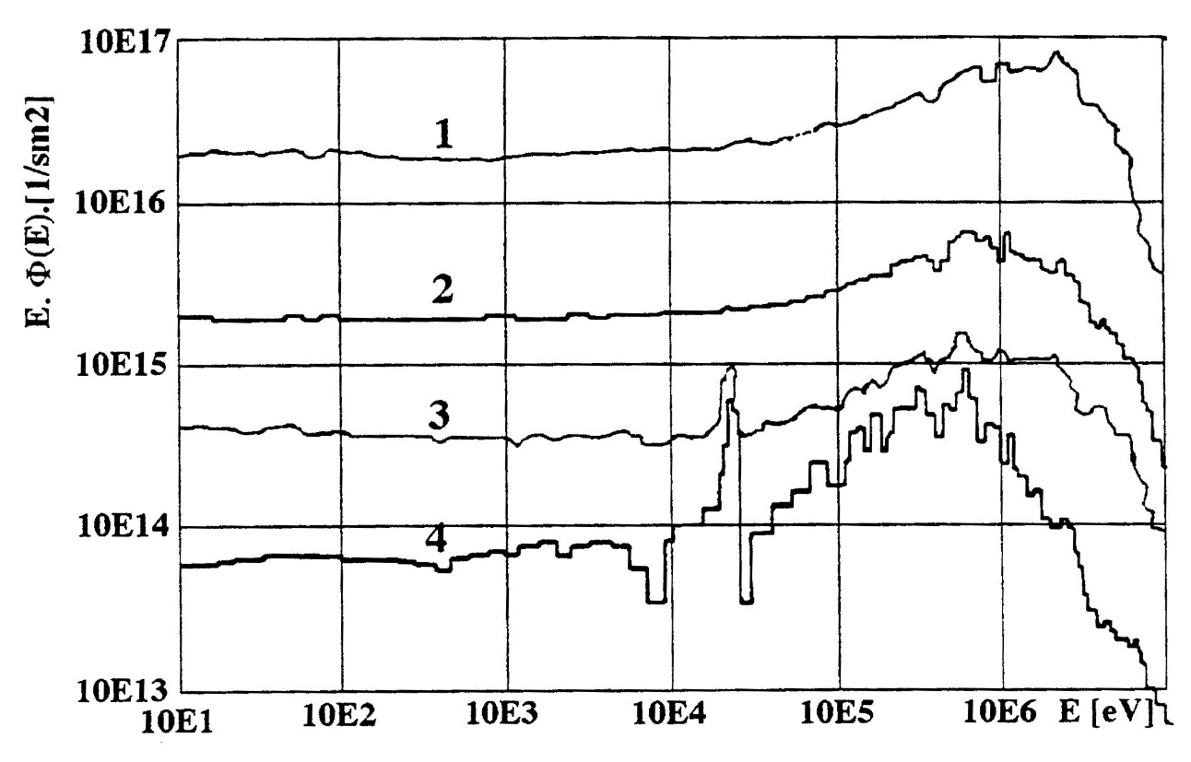
Neutron spectra of reactor WWER 440
Boundary of active zone
Outer surface of active zone vessel
Inner surface of reactor pressure vessel
Outer surface of reactor pressure vessel

Slide 6
 | VVER 440/230 | VVER 440/213 | VVER 1000
Project lifetime | 30 | 40 | 40
 | Maximum fluence (n/cm²) (>0,5 MeV)
Base material | 2,3 .10²⁰ | 2,6 .10²⁰ | 6,3 .10¹⁹
Welding metal | 1,6 .10²⁰ | 1,8 .10²⁰ | 5,7 .10¹⁹
 | Maximum fluence (n/cm²) (>1 MeV)
Base material | 1,4 .10²⁰ | 1,6 .10²⁰ | 3,7 .10¹⁹
Welding metal | 1,0 .10²⁰ | 1,1 .10²⁰ | 3,4 .10¹⁹

Slide 7
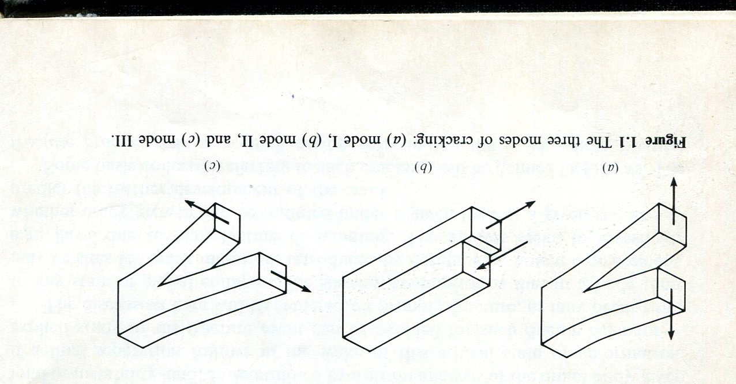

Slide 8
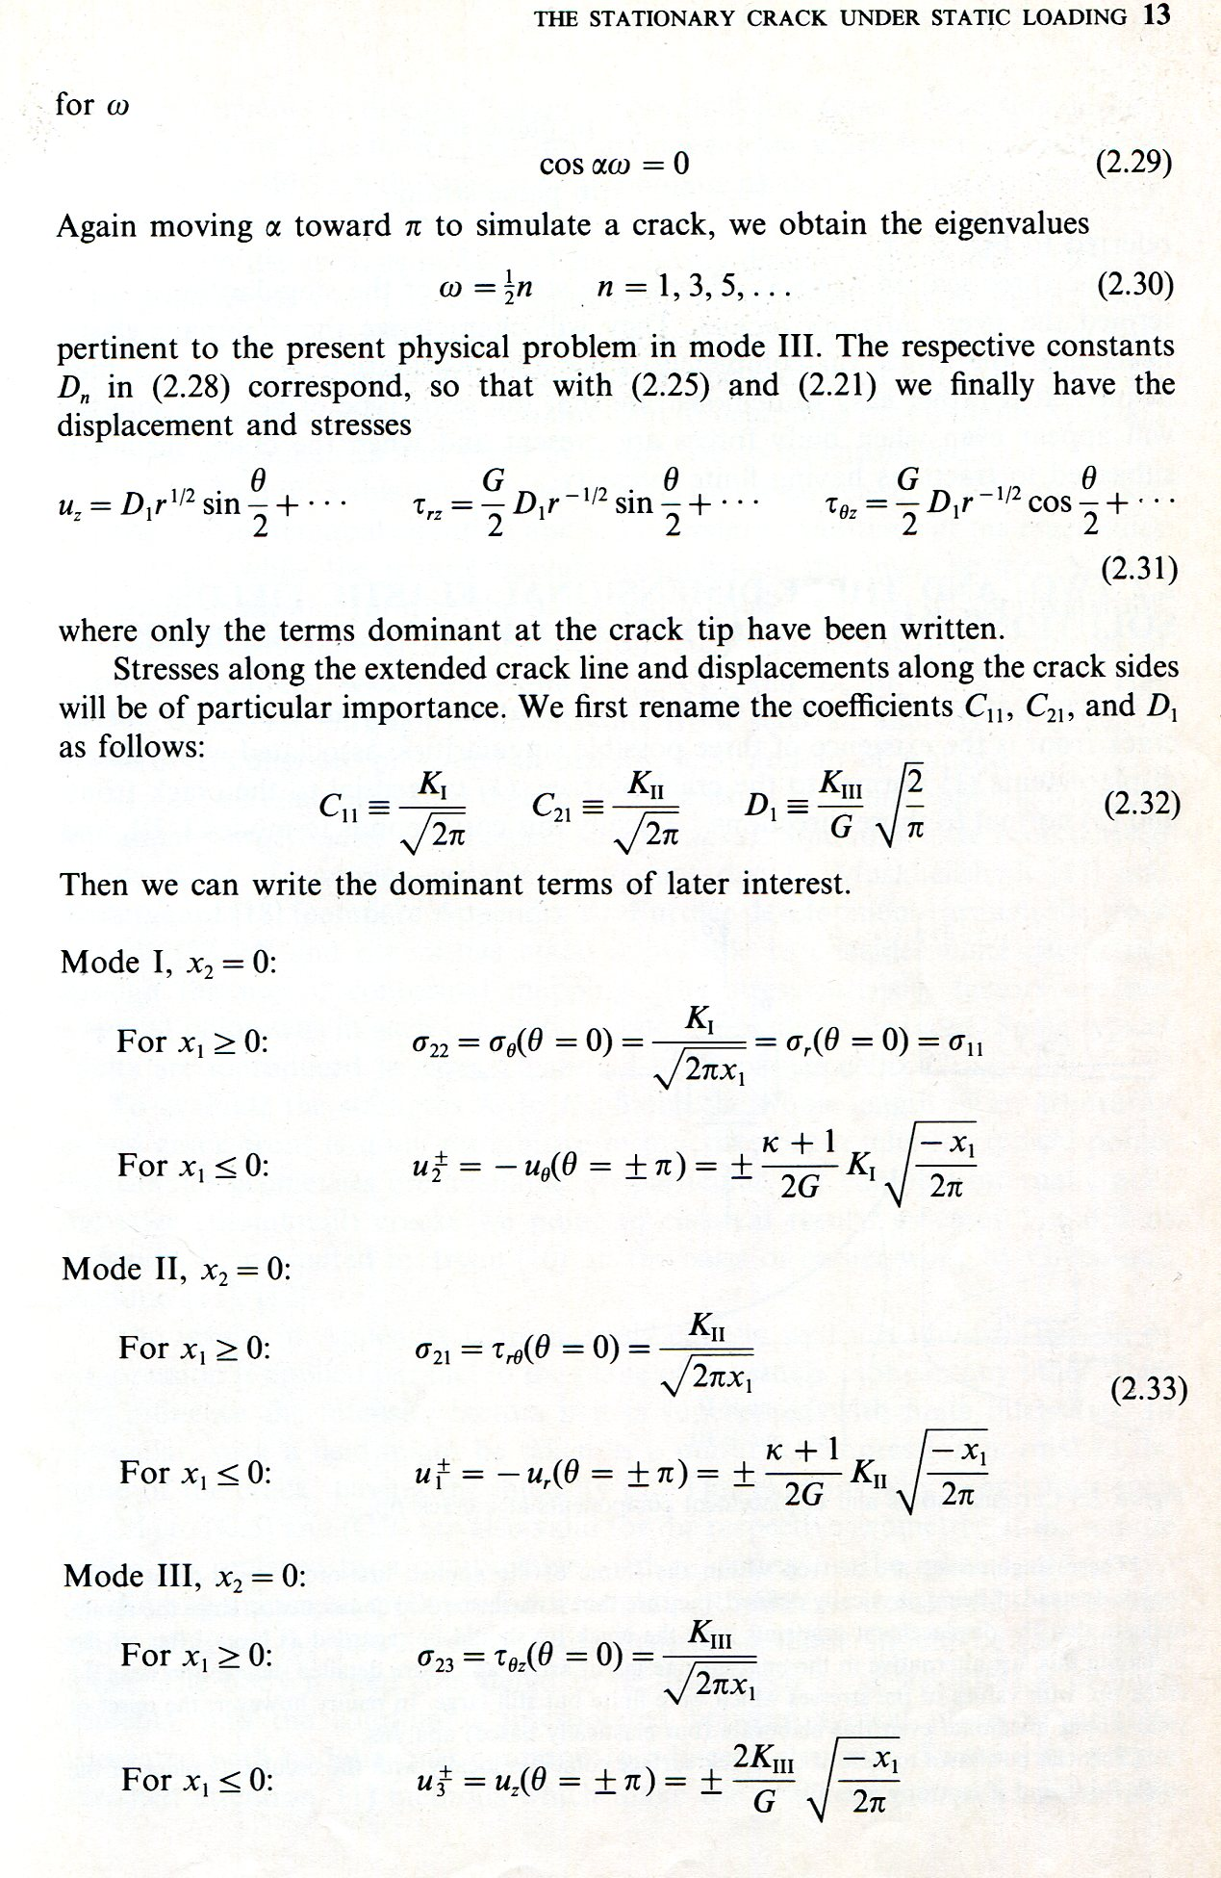
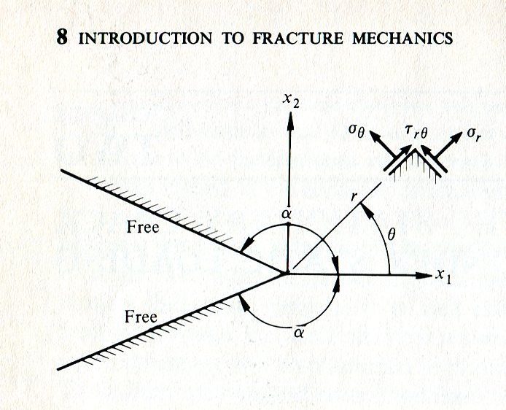

Slide 9
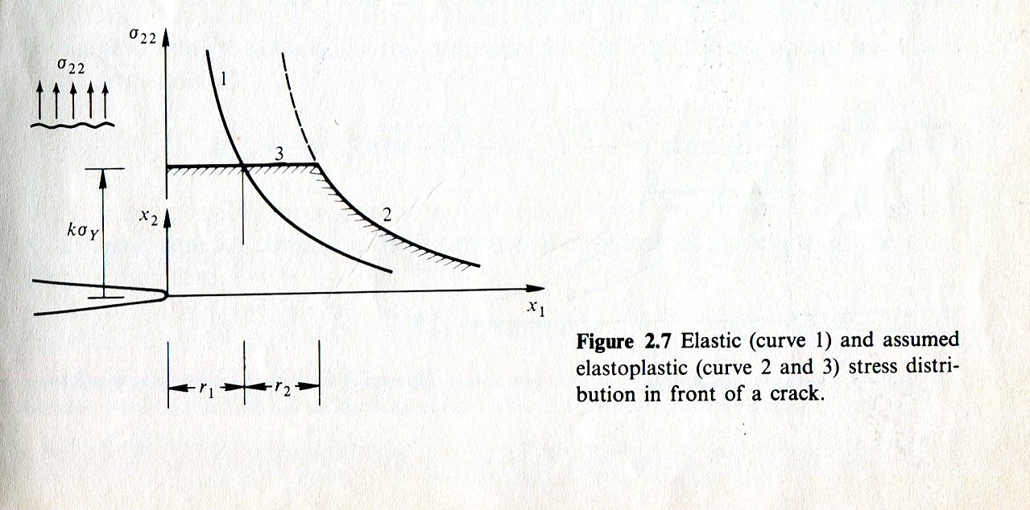
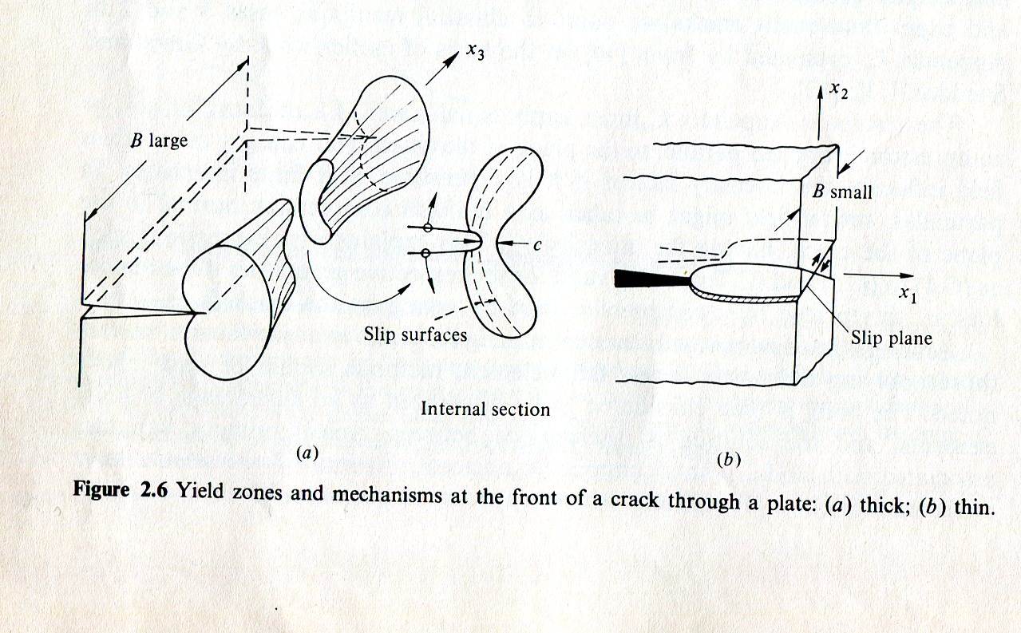
Hellan Kare: Introdution to Fracture mechanics, McGraw-Hill Book Company, 1984

Slide 10
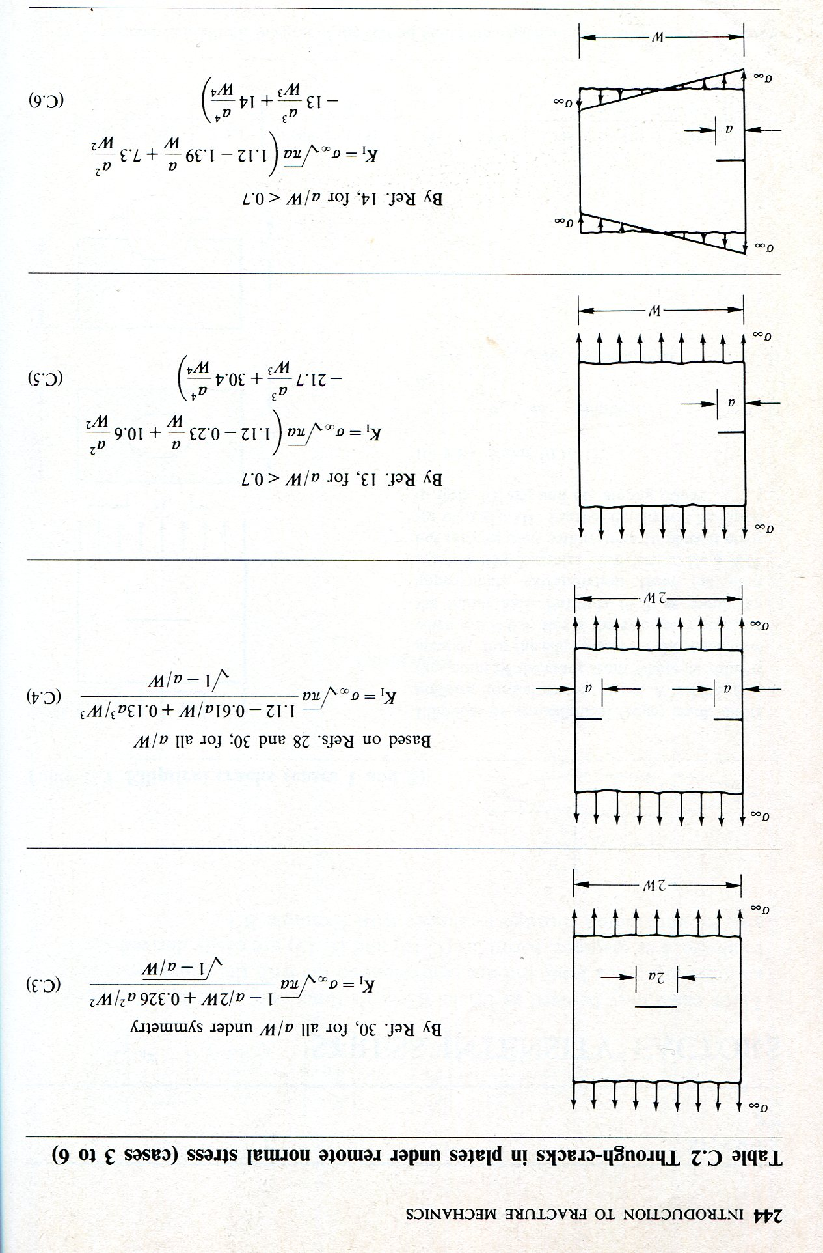

Slide 11
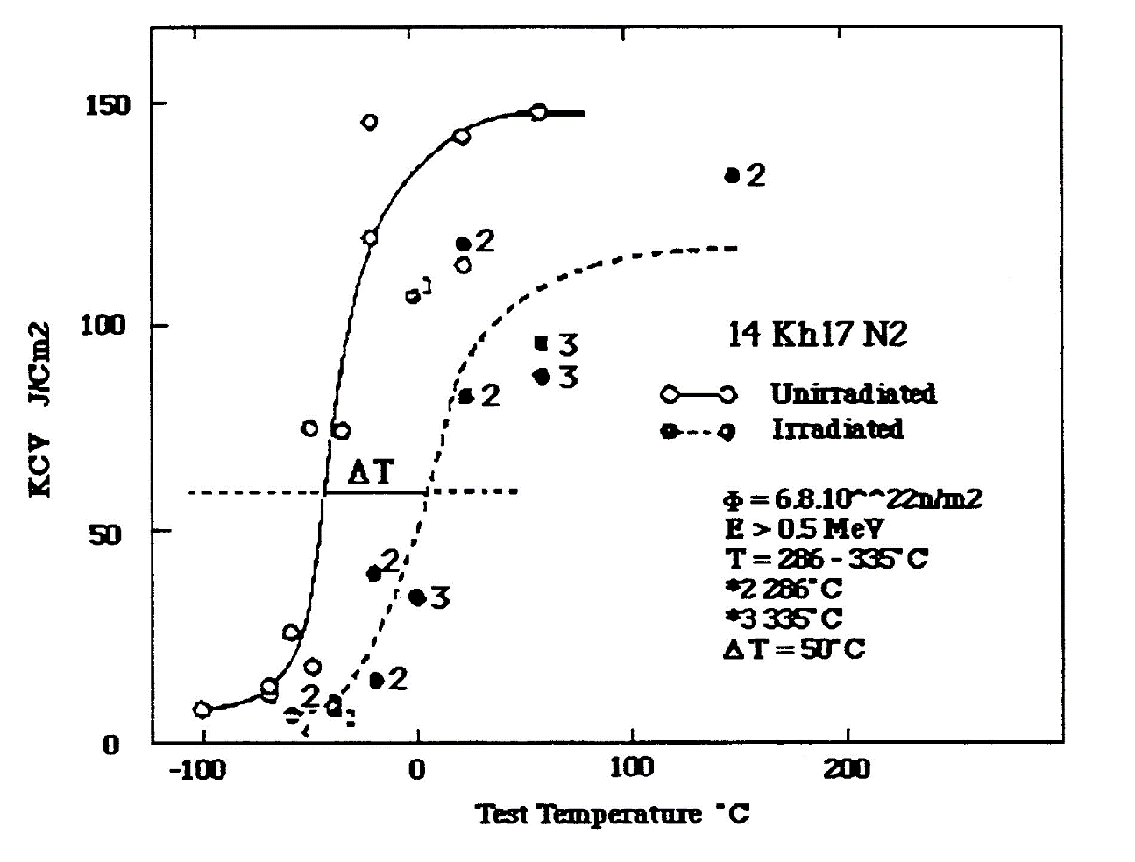
Fracture properties of reactor steel (temperature dependence)

Slide 12
Surveillance Programme

